Slide 1






NCC 101 Training
Mark Davis
September 2023

Slide 2
1. ABCB
2. IGA
3. ABCB structure
4. Hierarchy of building regulations
5. What the IGA says about the NCC
6. NCC structure
7. Consistent Volume Structure
8. Compliance pathways
9. Building classifications
10. NCC development cycle
11. Commercial energy efficiency provisions
12. Residential energy efficiency provisions
Contents:

Slide 3




Australian Building Codes Board (ABCB)
Established mid-1990s
Nationally consistent technical building regulations
States and Territories (S&Ts) are responsible for:
  Compliance and enforcement
  Licensing and accreditation
  Building approvals
Economic benefit
  National consistency
  Performance-based regulations
  Confirmed by CIE report

Slide 4
Inter-Governmental Agreement (IGA)
S&T funding proportional to level of building activity
  Commonwealth provides 50%
  Special account
Board
  Responsible for developing and maintaining the NCC
Building Ministers’ Meeting (BMM)
  Set strategic policy direction
  Approve ABCB annual business plan
IGA is updated every thee years

Slide 5
ABCB structure
BMM
18 Board members:
1 independent chair
8 S & T govts
1 Commonwealth
1 Local govt
7 Industry
Direction
Board
Project-specific Board Steering Committees
BCC:
25 members
2 observers
Industry reps include:
HIA
MBA
PCA
AFAC
AIA
BPIC
AIG
AIRAH
Direction
Office
More regular direction
PCC:
21 members
1 observer
Technical advice
Building Codes Committee (BCC)
Plumbing Code Committee (PCC)
Project-specific Technical Reference Groups (TRGs)

Slide 6

Hierarchy of building regulations
    Australian Constitution
    Note, Commonwealth does not have power in this area
State/Territory
Building Acts and Regulations
Administrative matters
Approvals, licensing, etc
National Construction Code
ncc.abcb.gov.au
Referenced documents & Software
Including Australian Standards, NABERS, NatHERS

Slide 7
What the IGA says about the NCC
Performance-based
Minimum necessary regulation to achieve society’s expectations
Covers new work on both new and existing buildings
  S&Ts determine applicability to existing buildings (e.g. 50% rule)
Covers design, construction, performance and livability
  Not occupation and ongoing operation
3-yearly amendment cycle
Grounds for S&T variations
  Reported to BMM
NCC objectives:
  Safety and health
  Amenity and accessibility
  Sustainability
Focus on occupants,
NOT property protection

Slide 8




NCC structure
Volume One
(Class 2-9 Buildings)
Building Code
of Australia (BCA)
Volume Two
(Class 1 & 10)
National Construction Code
Housing Provisions
(detailed DTS)
Plumbing Code of Australia (PCA)
Volume Three
(Class 1 -10)

Slide 9

Consistent Volume Structure (CVS)
Governing requirements
  How to use the NCC
Technical Requirements
  Objectives
  Functional statements
  Performance Requirements
  Verification Methods
  Deemed-to-Satisfy (DTS) Provisions
    Prescriptive ‘recipe book’
Definitions
Referenced documents
S&T variations

Slide 10
Compliance Pathways
PERFORMANCE REQUIREMENTS
PERFORMANCE SOLUTION
DTS
SOLUTION
AND/ OR
Documentary Evidence
Verification Method
ASSESSMENT METHODS
Expert Judgement
Comparison to DTS

Slide 11
Building classifications
Class 1:
  1a Detached house or townhouse with fire wall
  1b Small boarding house
Class 2: Apartment
Class 3: Hotel, student accommodation
Class 4: Sole-occupancy unit (SOU) within another classification
Class 5: Office
Class 6: Retail
Class 7:
  7a Carpark
  7b Warehouse
Class 8: Laboratory, factory
Class 9:
  9a Hospital
  9b Auditorium
  9c Aged care
Class 10:
  10a Carport
  10b Mast, antenna
  10c Bushfire shelter

Slide 12






NCC Amendment Cycle
PLANNING PHASE
DEVELOPMENT PHASE
FINALISATION PHASE
Business plan approved (mid-2022)
Project management brief developed
Resources established
Sub-committees formed (i.e. Board Steering Committee, Technical Reference Group)
External experts procured
Research and modelling undertaken
Public comment draft (PCD) produced
Consultation impact assessment produced
Public consultation undertaken (April/ May 2024)
NCC provisions and impact assessment finalised
Board and BMM approvals obtained
Publish new NCC edition (early 2015)
Roadshow and webinars
New edition adopted (1 May 2025 with possible transitional period)

Slide 13
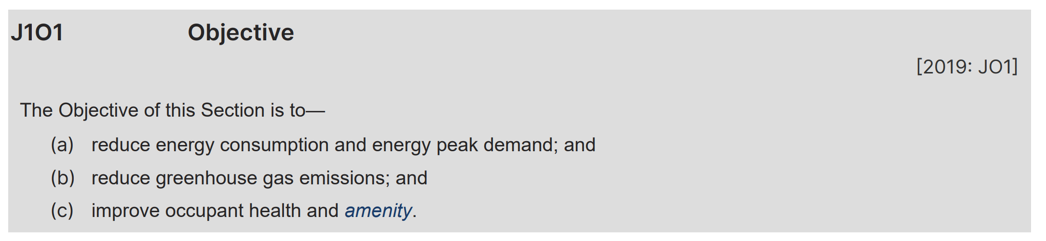
Commercial Energy Efficiency Provisions
Objectives

Slide 14
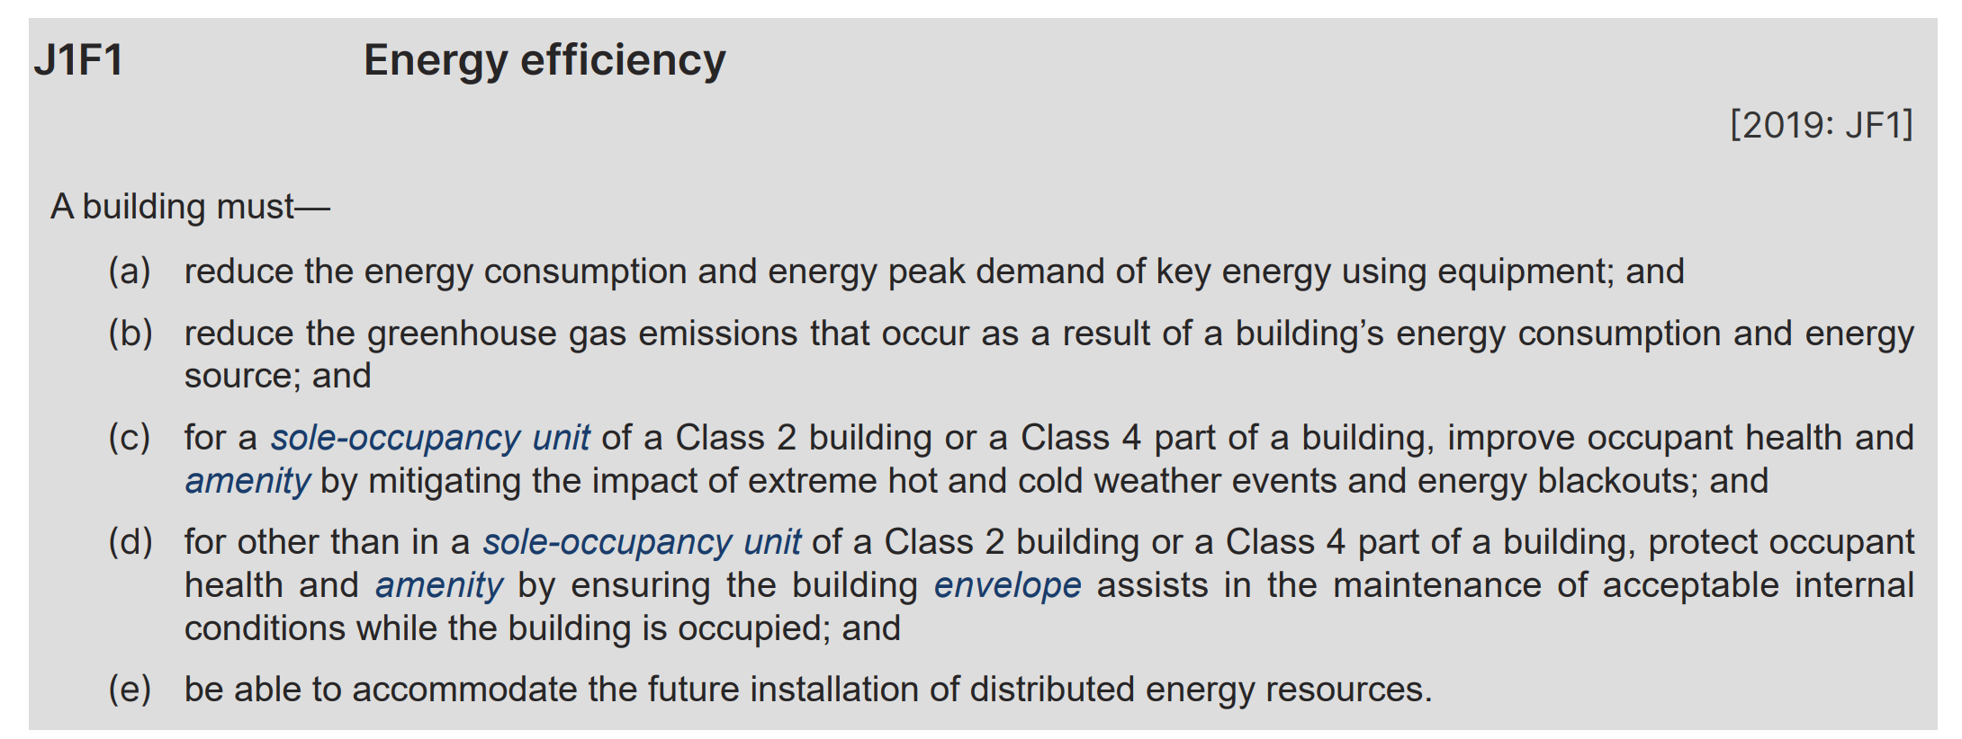
Commercial Energy Efficiency Provisions
Functional Statement

Slide 15
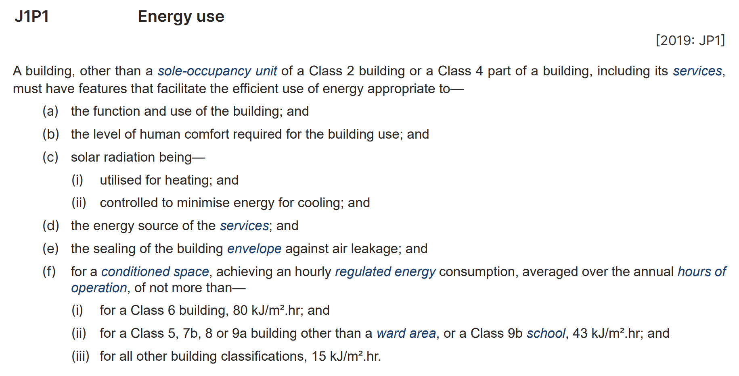
Commercial Energy Efficiency Provisions
Performance Requirements
  JPI Energy Use

Slide 16
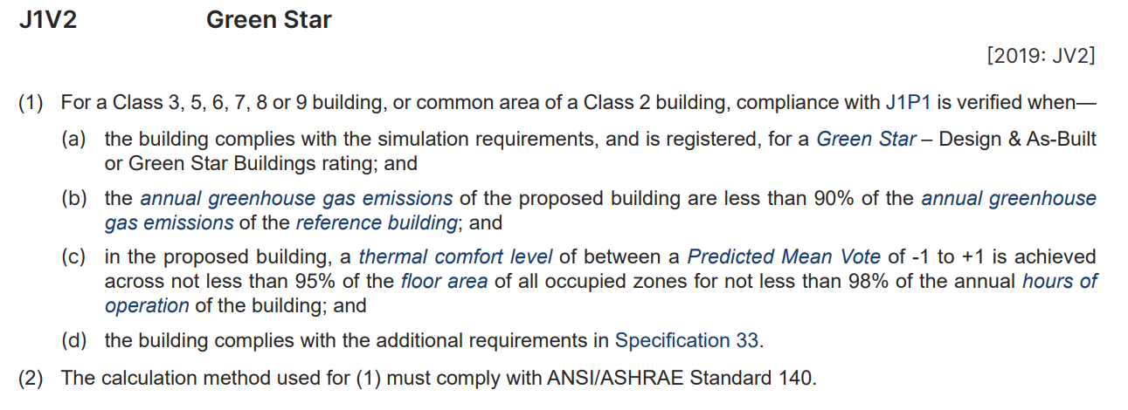
Commercial Energy Efficiency Provisions
Verification Methods
  J1V1 NABERS
  J1V2 Greenstar
  J1V3 Reference building VM
  J1V34 Sealing

Slide 17
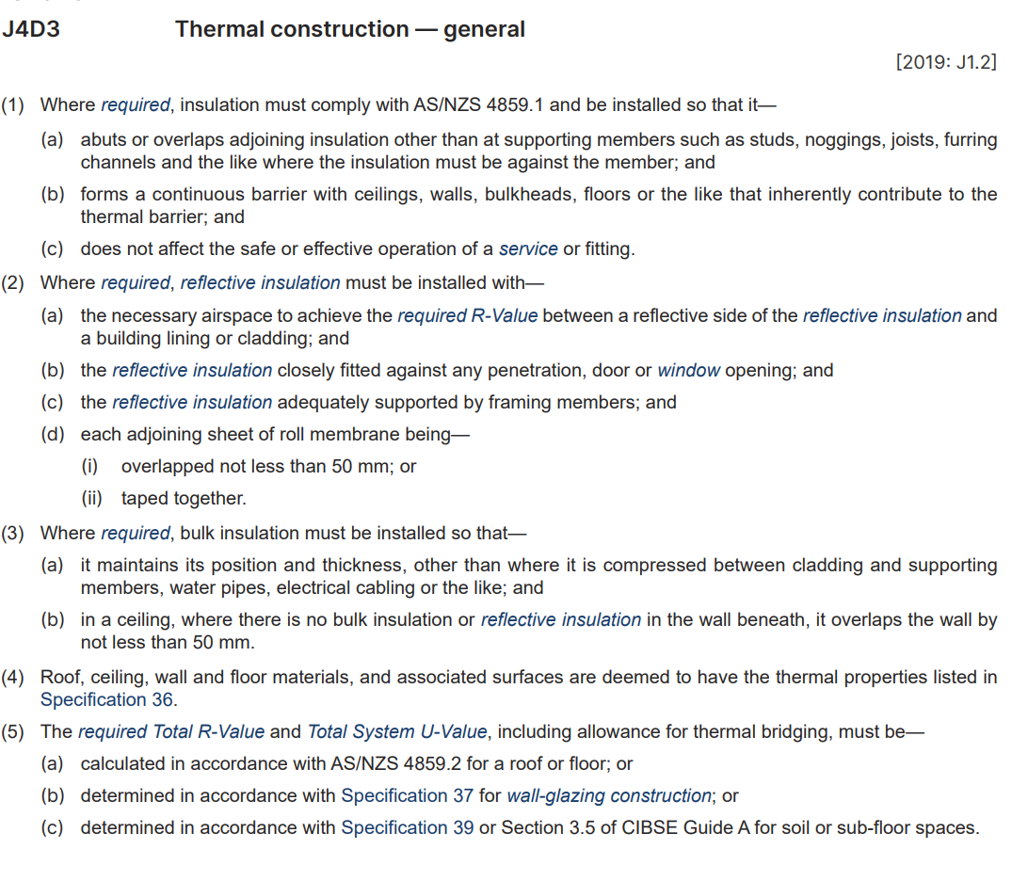
Commercial Energy Efficiency Provisions
DTS
  Part J2 Application
  Part J4 Fabric
  Part J5 Sealing
  Part J6 Air-conditioning & ventilation
  Part J7 Artificial lighting & power
  Part J8 Heated Water
  Part J9 Energy monitoring & on-site distributed
    energy resources

Slide 18
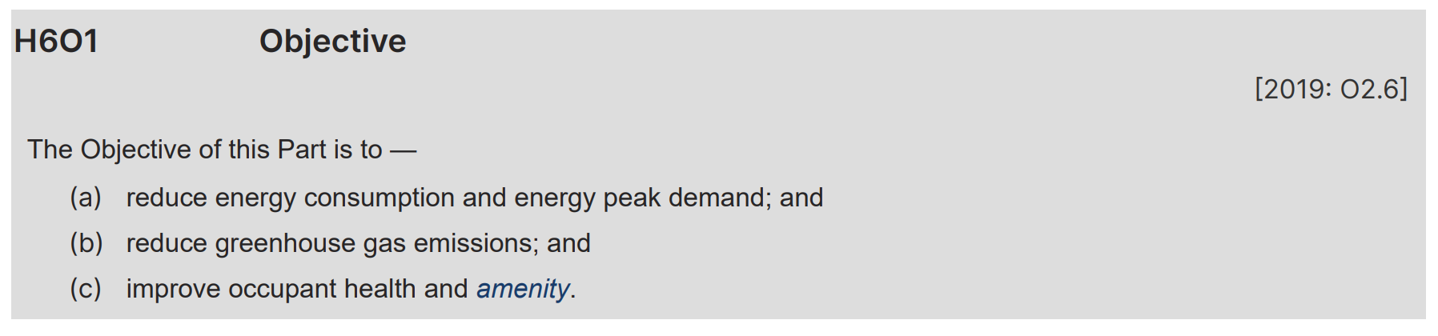
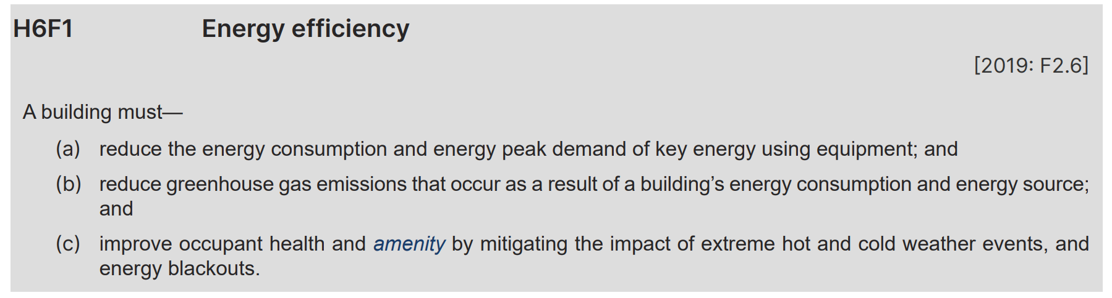
Residential Energy Efficiency Provisions
Objective (guidance)
Functional Statement (guidance)

Slide 19
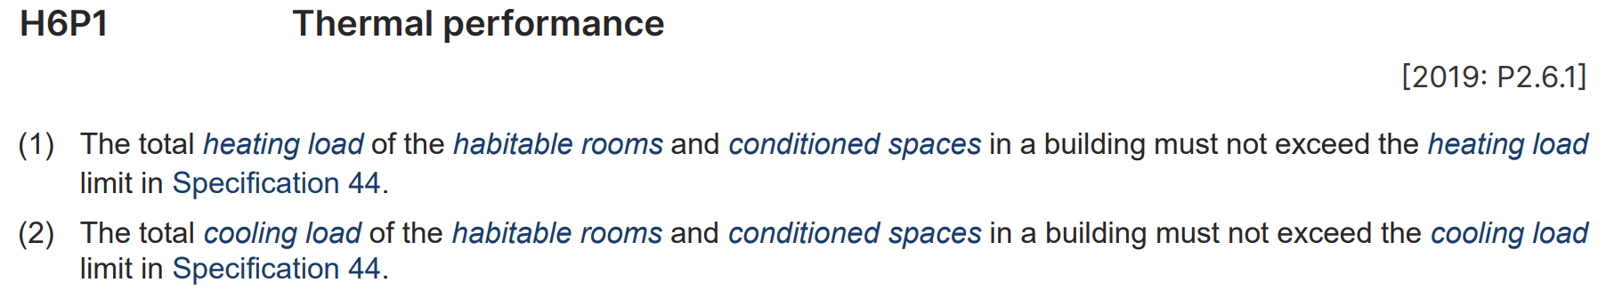
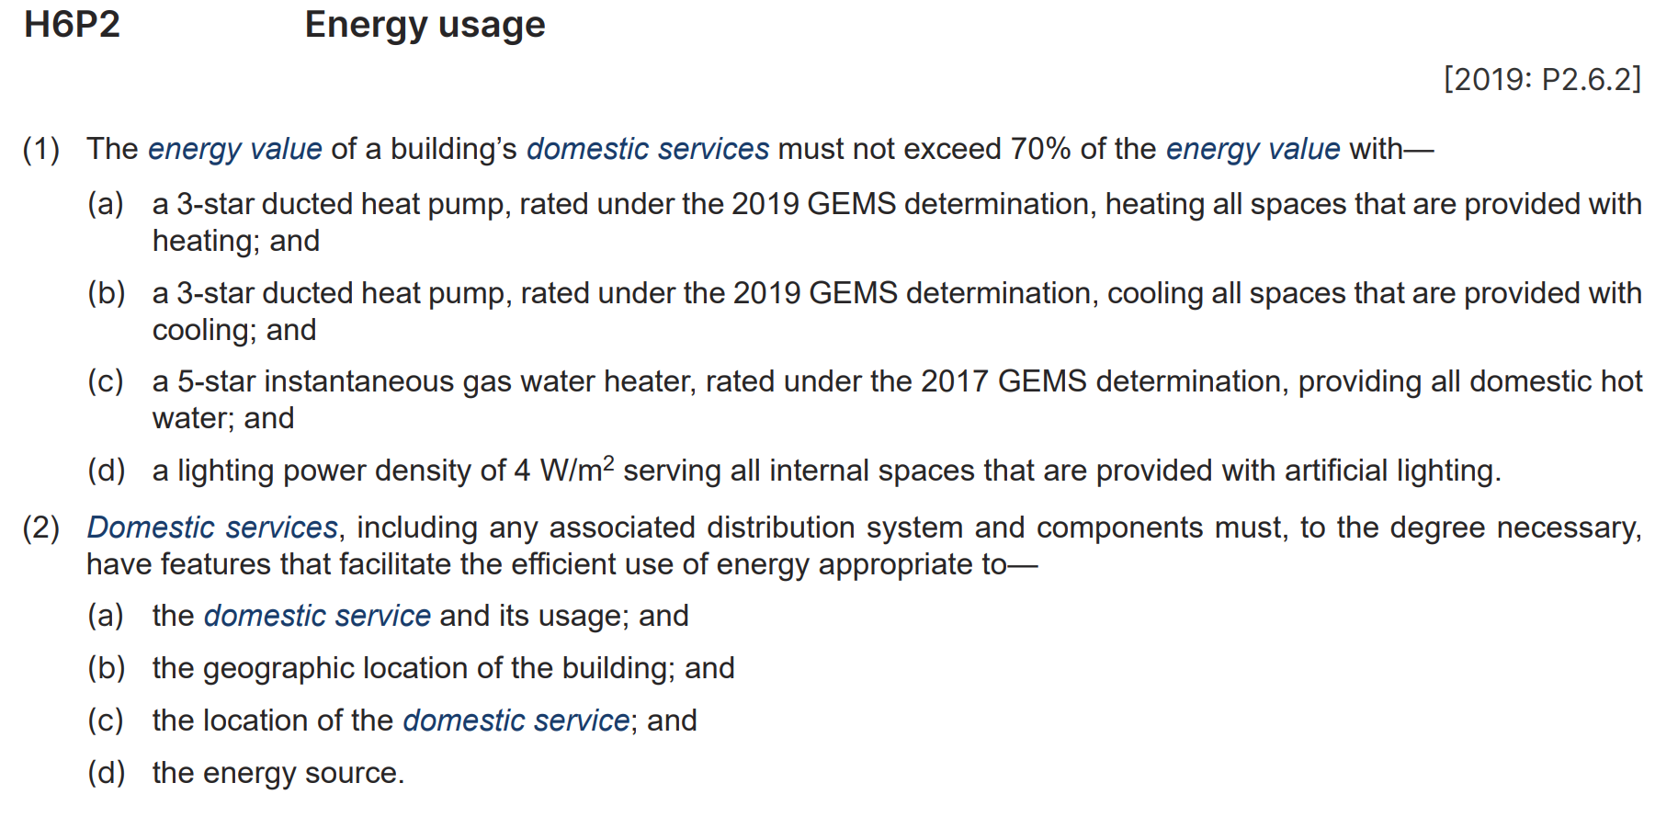
Residential Energy Efficiency Provisions
Performance Requirements (mandatory)
  Thermal Comfort
  Whole-of-home

Slide 20
Residential Energy Efficiency Provisions
Compliance Pathways
PERFORMANCE REQUIREMENTS
PERFORMANCE SOLUTION
DTS
SOLUTION
AND/ OR
Verification using a reference building (VURB)
NatHERS
Verification of building envelope sealing
DTS elemental provisions

Slide 21

Residential Energy Efficiency Provisions
NatHERS Compliance Pathways
  Specification 42
    7 stars unless outdoor living area in climate zones 1 and 2
    Heating and cooling load limits
    Whole of home rating ≥ 60
    Additional DTS elemental provisions (ABCB Housing Provisions):
      Insulation
      Thermal breaks
      Compensating for loss of ceiling insulation
      Floor edge insulation
      Sealing

Slide 22
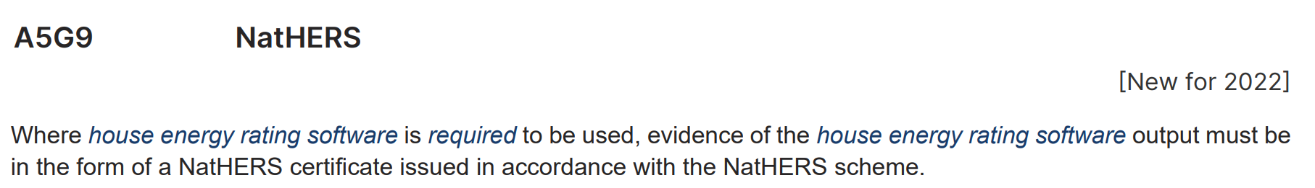
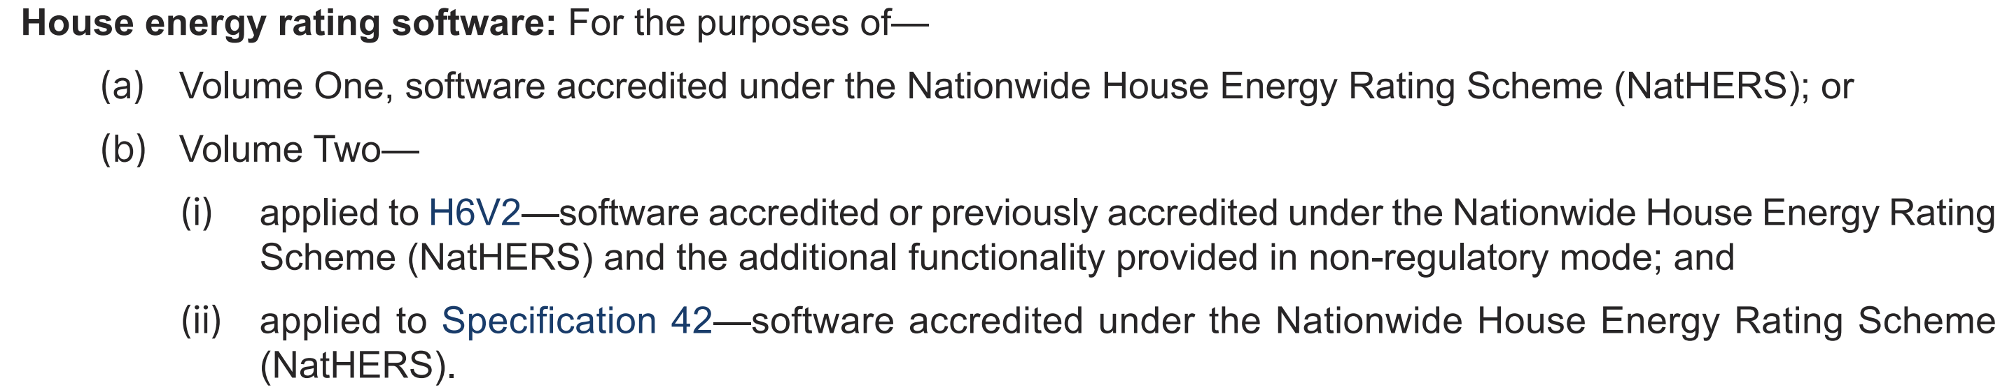
Residential Energy Efficiency Provisions
NatHERS Compliance Pathways
  NatHERS certificate
  NatHERS definition

Slide 23
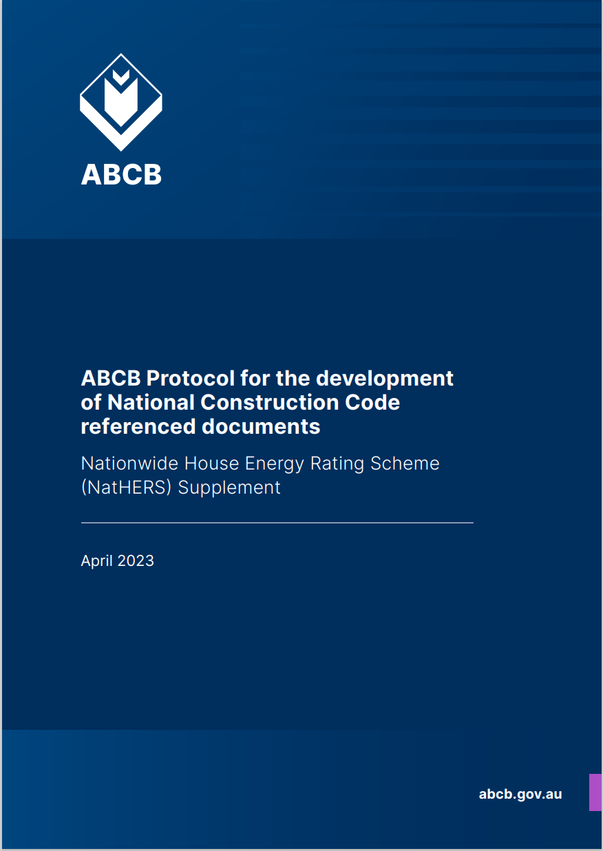
Residential Energy Efficiency Provisions
NatHERS Supplement
  Minor changes
  Major changes process
    Proposal Stage
    Development stage
    Consultation stage
    Finalisation stage

Slide 24
Thank you for your time
© Australian Building Codes Board 2022
The National Construction Code can be accessed free online at ncc.abcb.gov.au

