Slide 1
NatHERS Whole of Home Technical
Presenter(s): Michael Young
Date: 22 August 2023
DCCEEW.gov.au

Slide 2
Source: Barramundi, Aboriginal x-ray art. Photo: Jon Connell. Creative Commons BY 2.0 (cropped)

Slide 3
Scope
In this webinar we will cover:
Overview of Whole of Home
Undertaking a Whole of Home Assessment
Heating and Cooling Appliances
Hot Water
Lighting
Pools and Spas
On-Site Renewable Energy
On-Site Energy Storage
Plug Loads and Cooking Loads
Questions

Slide 4
Disclaimer
This webinar DOES NOT cover any software or tool. Please speak with software developers to learn about the timings for the release of their Whole of Home product and for training in the use of that tool.
A Demo of the Benchmark tool is available: https://www.nathers.gov.au/WholeofHome/software-development
This webinar assumes that you have completed either the Overview webinar or have a basic understanding of Whole of Home.

Slide 5
Overview of NatHERS Whole of Home

Slide 7
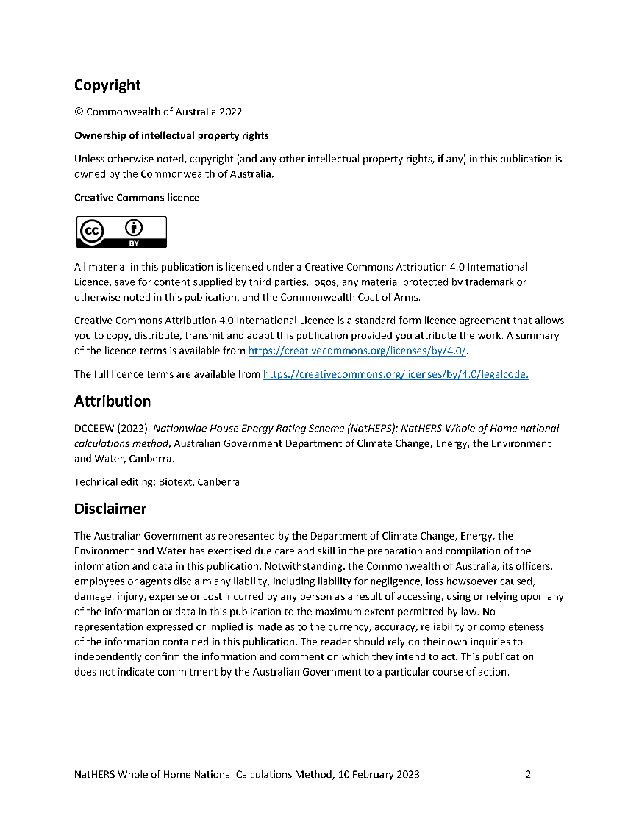
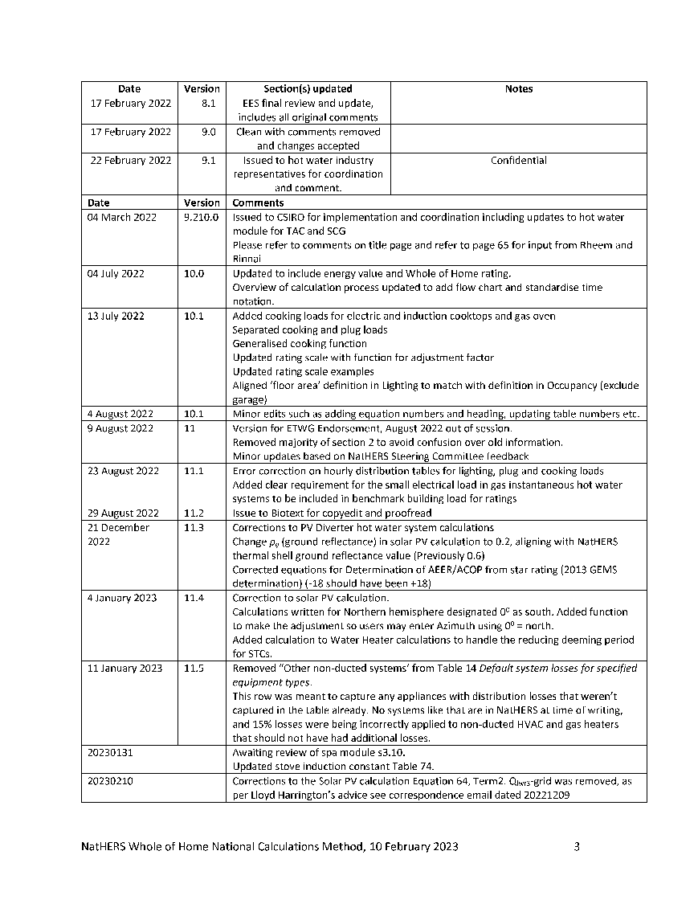
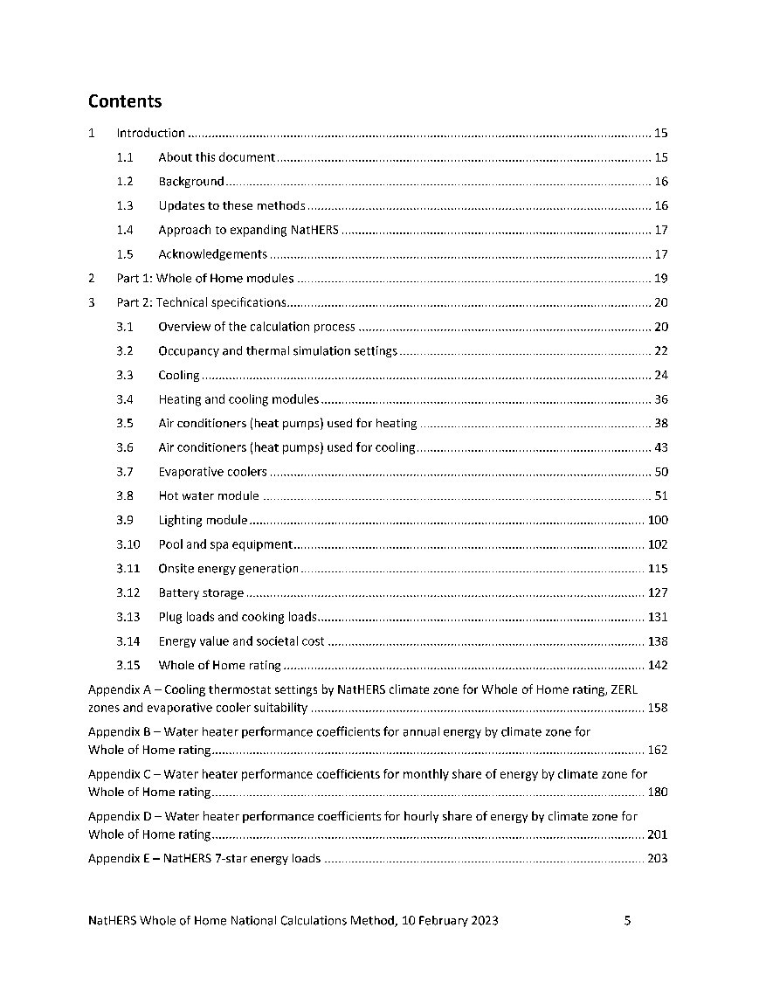
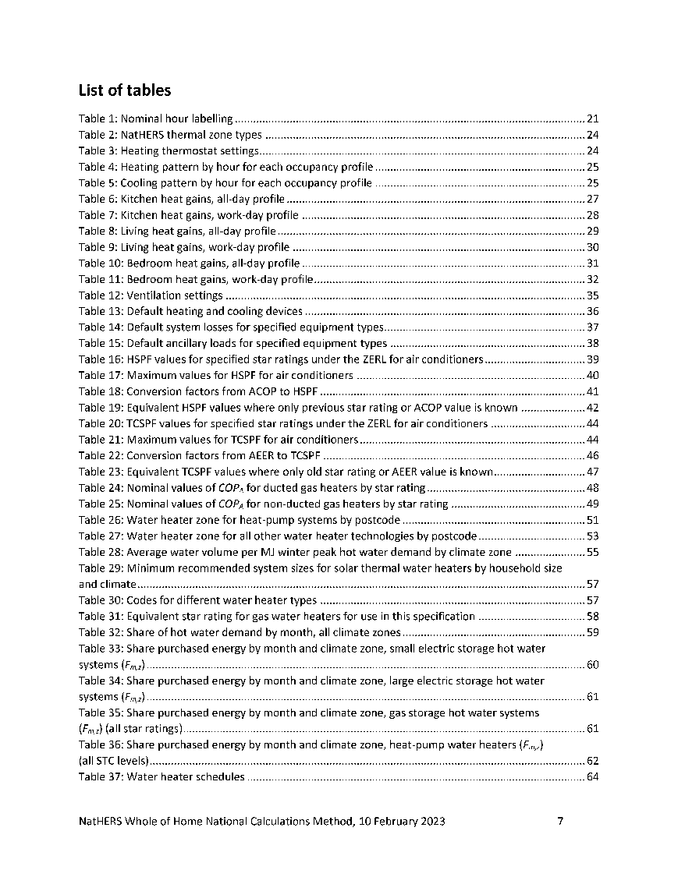
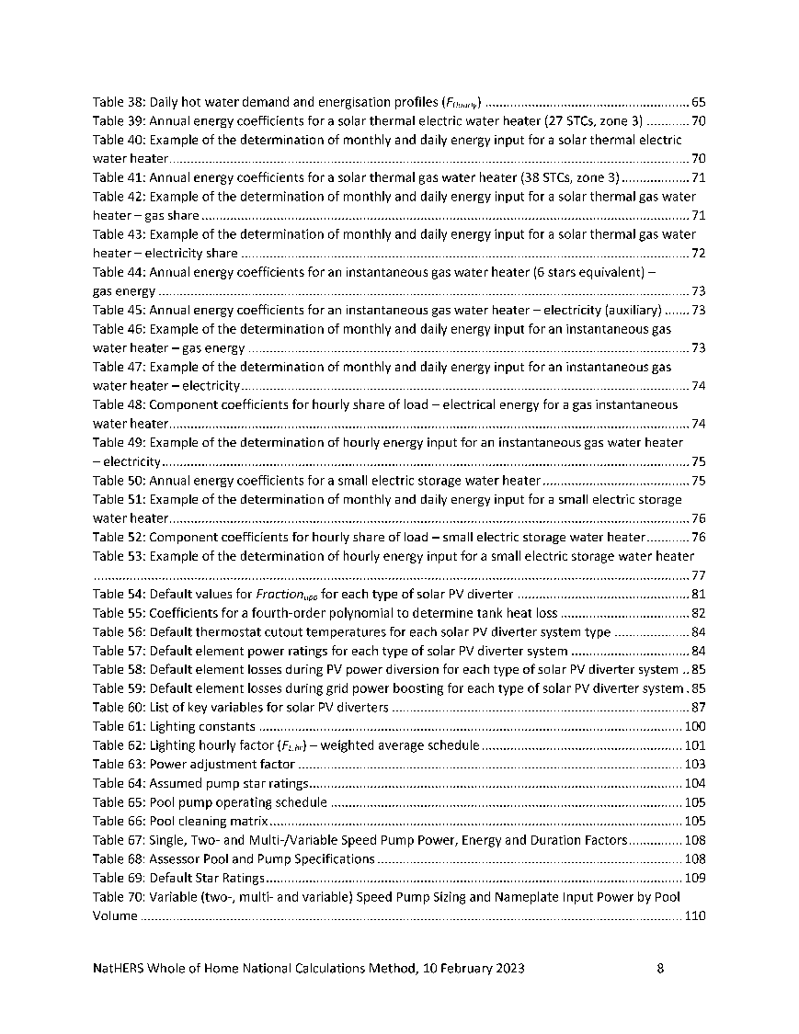
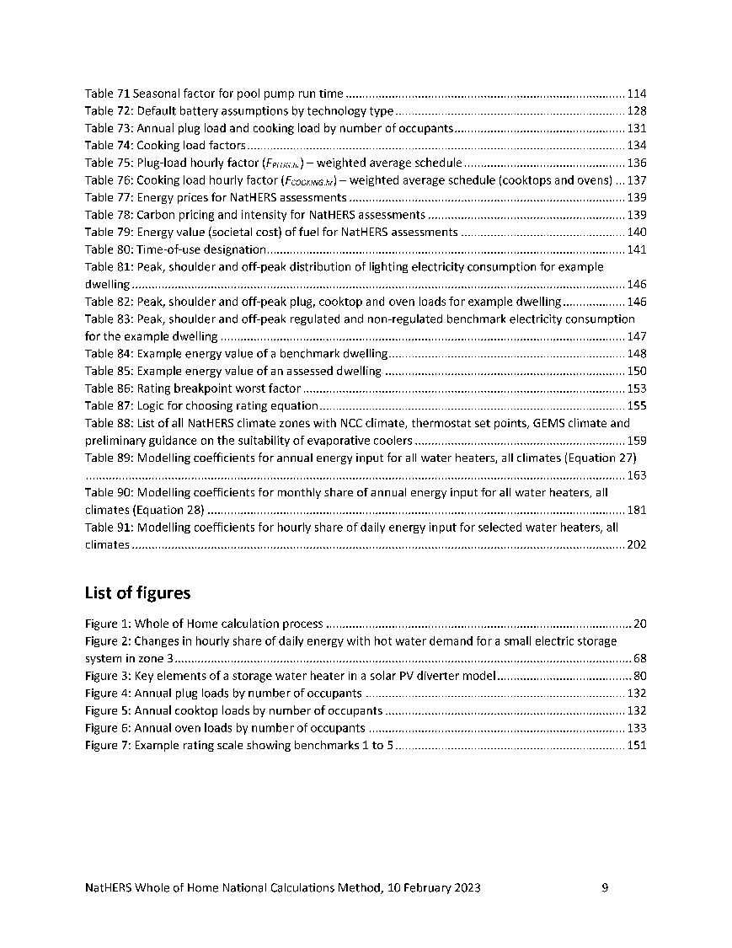
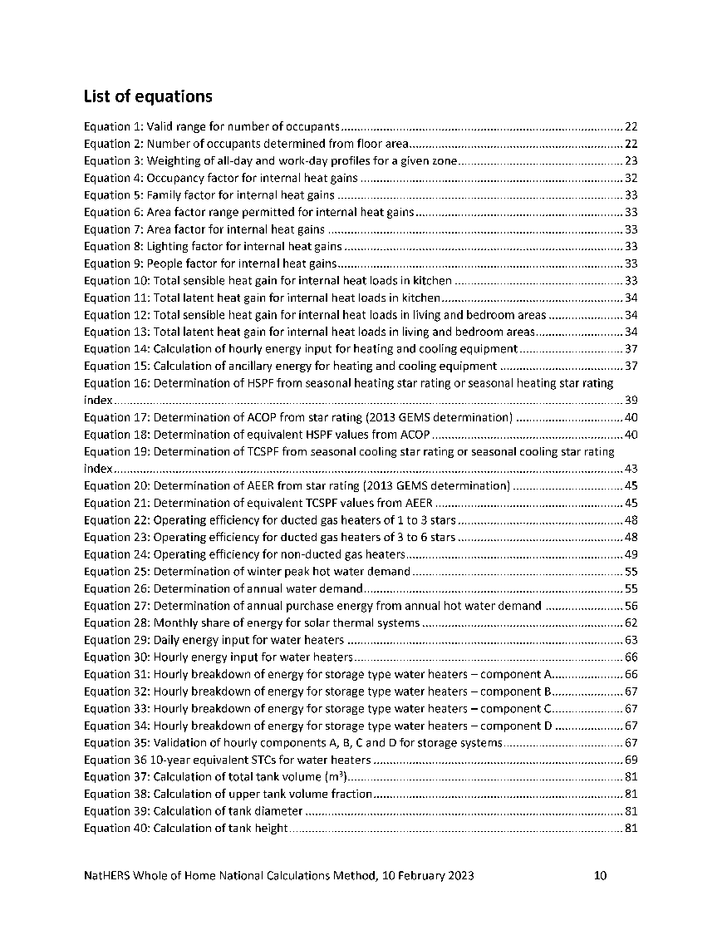
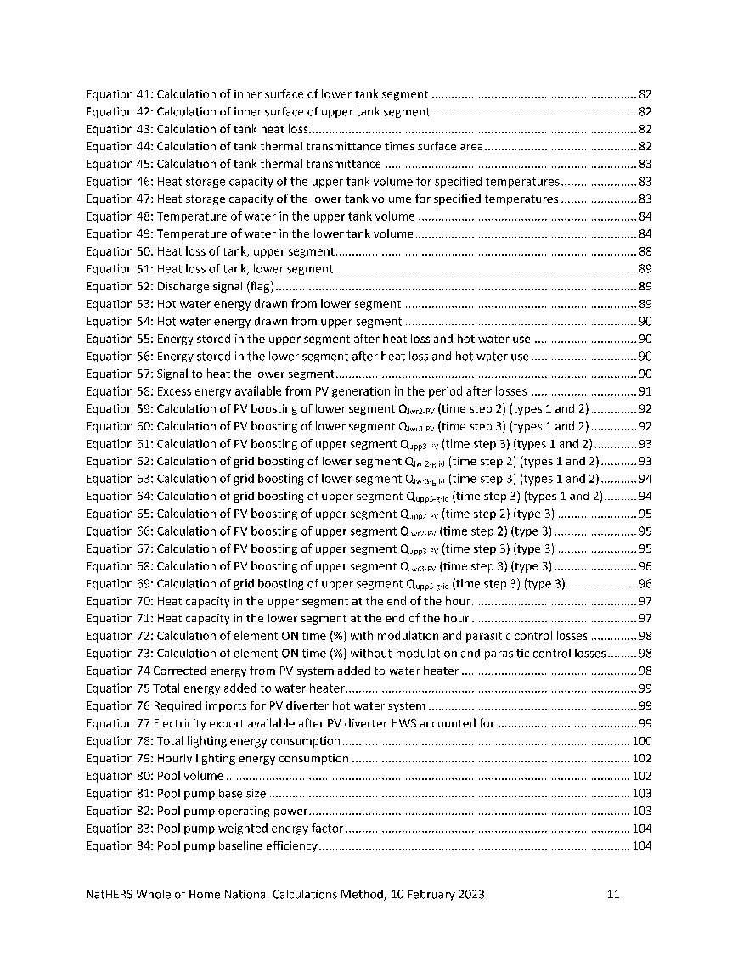
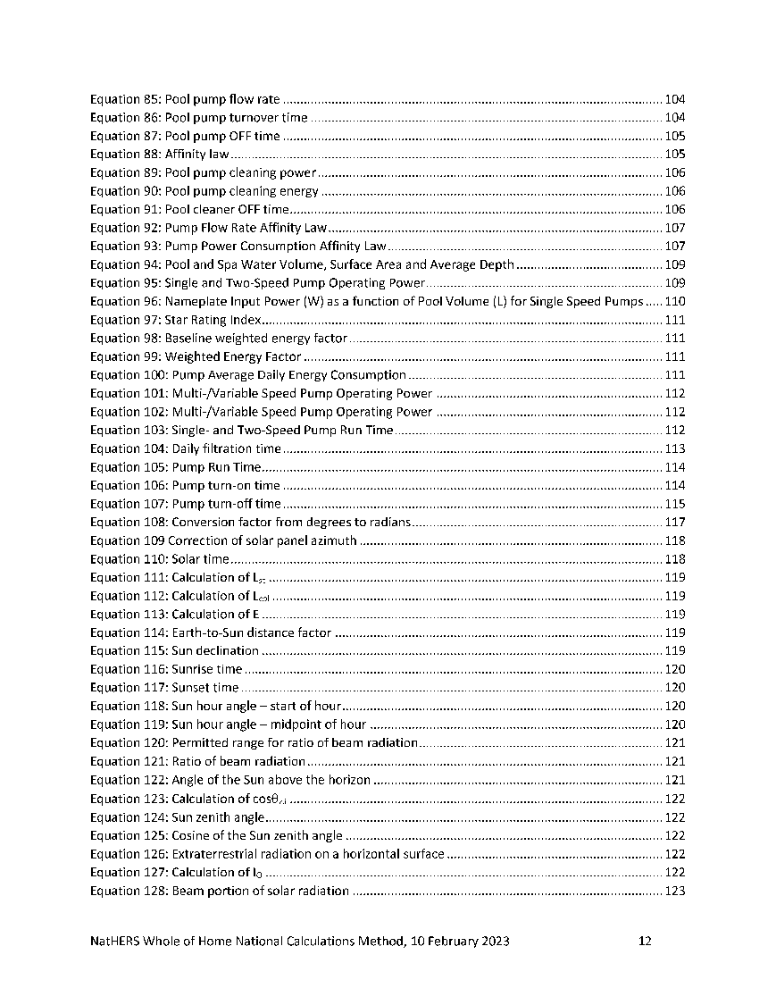
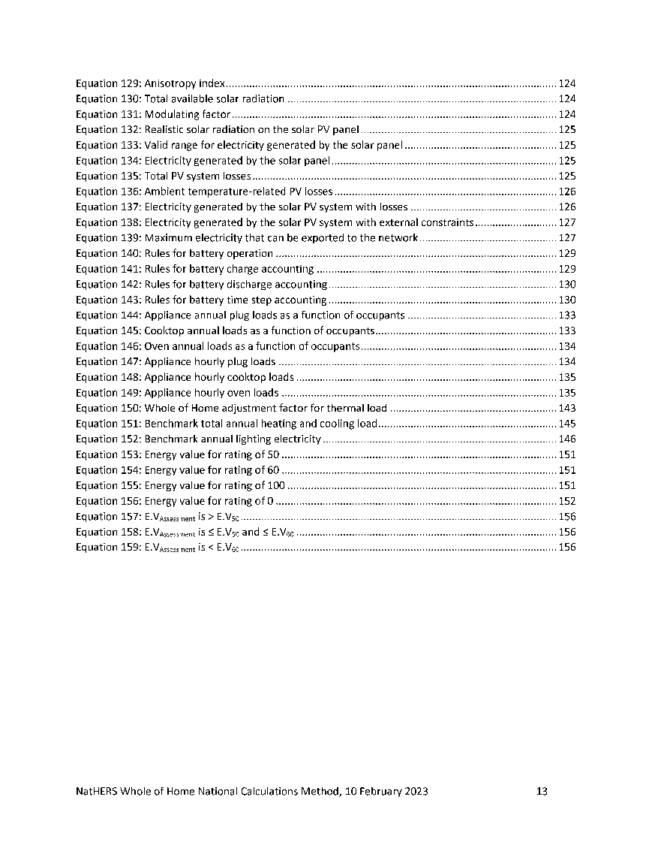
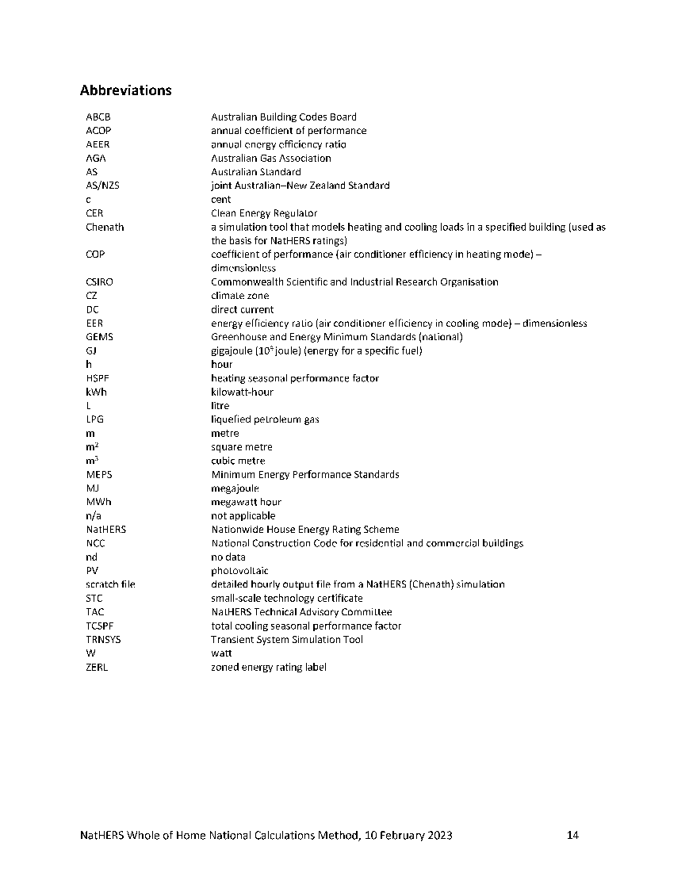

Slide 8
Undertaking a Whole of Home Assessment

Slide 9
NatHERS Assessment?
The NatHERS Whole of Home assessment builds on the existing NatHERS thermal assessment that is used to verify compliance with the energy efficiency performance requirements of the NCC.
From 1 October 2023, there will be two energy efficiency performance requirements for residential buildings under the NCC:
the thermal performance -> Thermal Assessment
the energy usage performance -> Whole of Home performance rating

Slide 10
NCC 2022 Transition arrangements
1 May 2023 - 30 September 2023

Slide 11
NCC 2022 Transition arrangements
State and territory variations may apply where jurisdictions require Assessors to use specific versions of the NCC

Slide 12
NCC 2022 Transition arrangements
Assessment meeting the NSW BASIX thermal performance standards must continue to use v3.21 software until 30 September 2023

Slide 13
Compliance with NCC 2019
If you choose to comply with NCC 2019, you must use:
Chenath
Engine
v3.21
Thermal only NatHERS
certificate
Technical Note June 2019
ABCB Standard 2019.1
load limits
Clause J0.2
NCC 2019
Volume 1
Subclause 3.12.0(a)(i) NCC 2019 Volume 2

Slide 14
Compliance with NCC 2022
If you choose to comply with NCC 2022, you must use:
Chenath
Engine
v3.22*
NatHERS
Certificate with WoH
Technical Note Sep 2022
ABCB Standard 2022.1
load limits
Section J2D2
NCC 2022
Volume 1
Specif. 42 NCC 2022 Volume 2
*When available

Slide 15
From 1 October 2023 onwards
Chenath
Engine
v3.21 not compliant
Chenath
Engine
v3.21 via request
Chenath
Engine
v3.22 only
NatHERS
Certificate with WoH

Slide 16
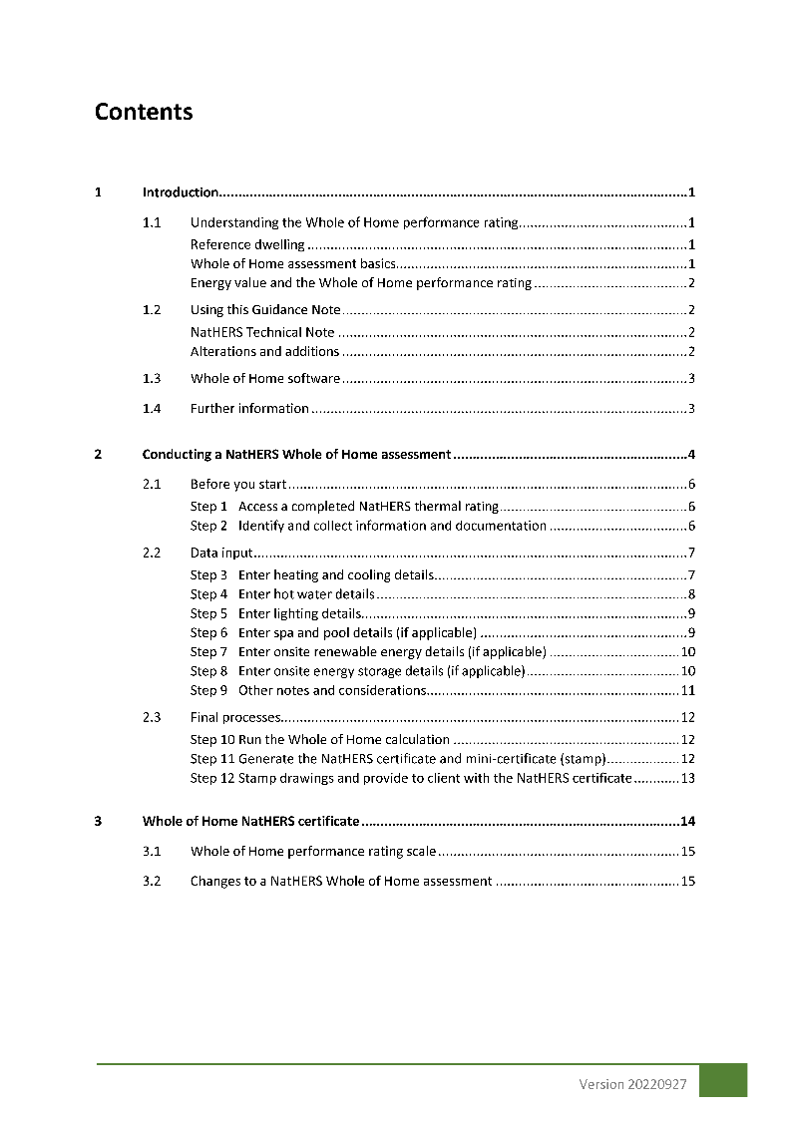
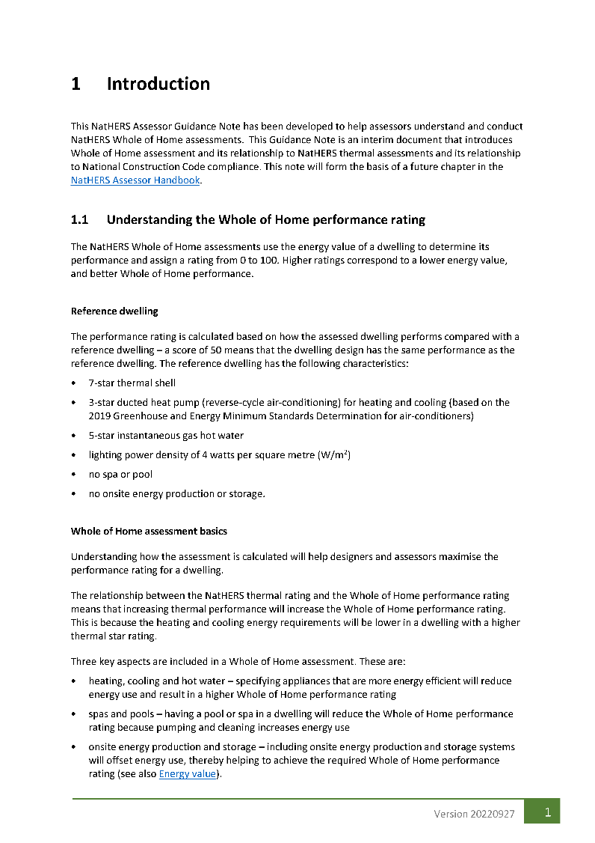
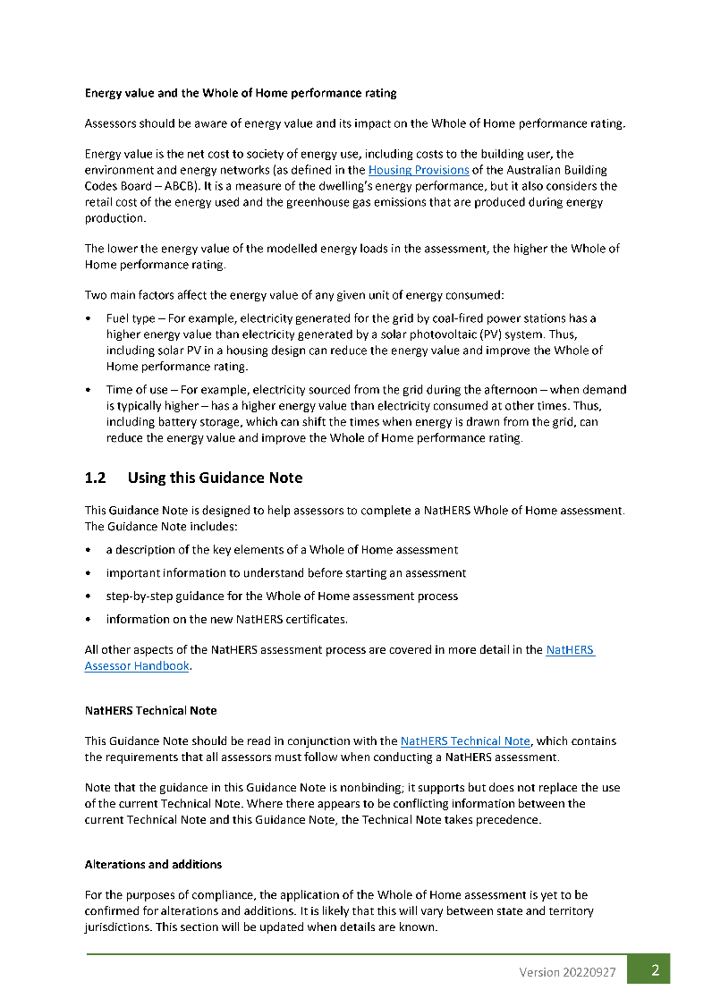
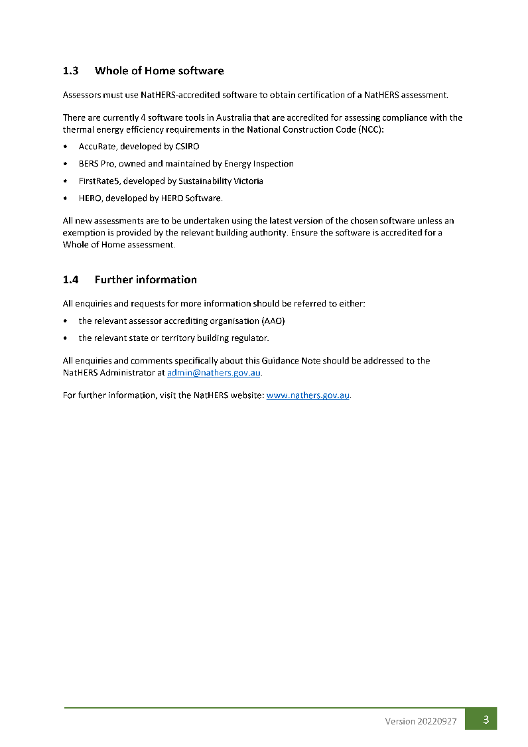
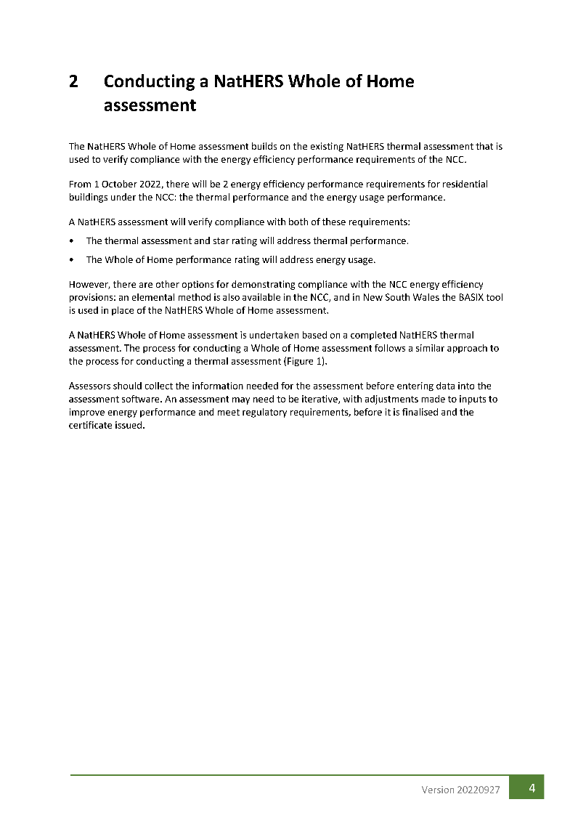
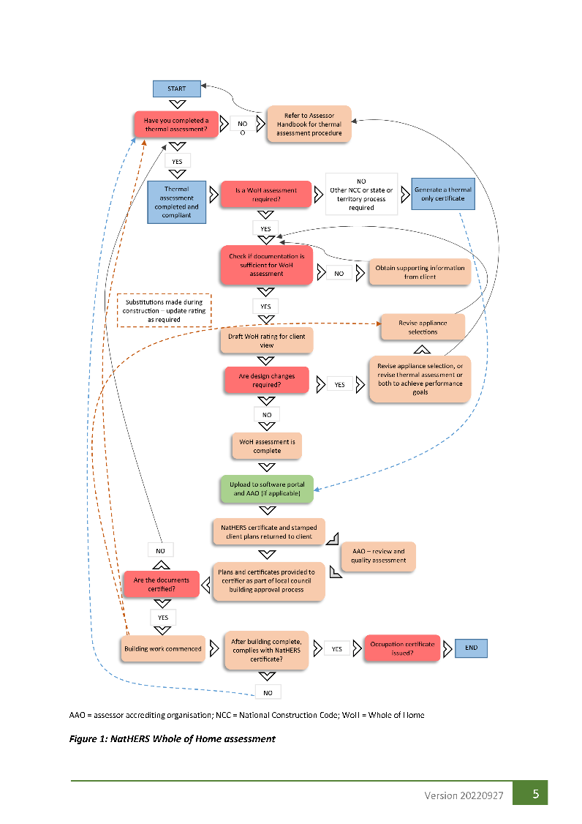
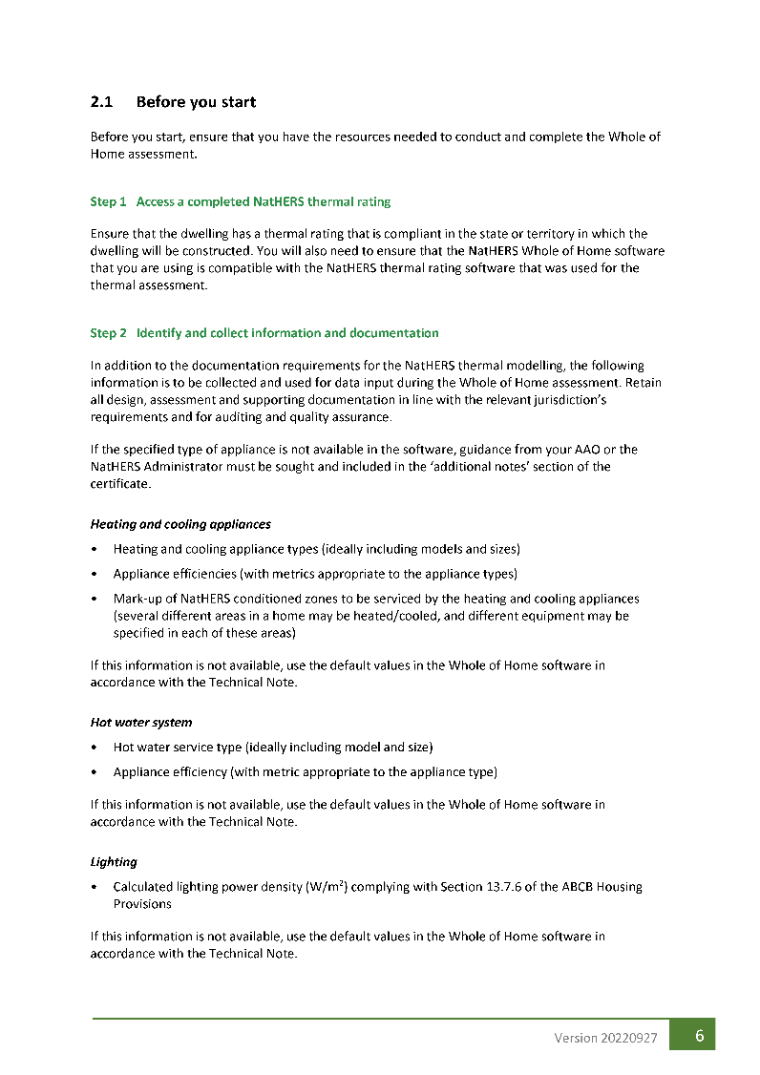
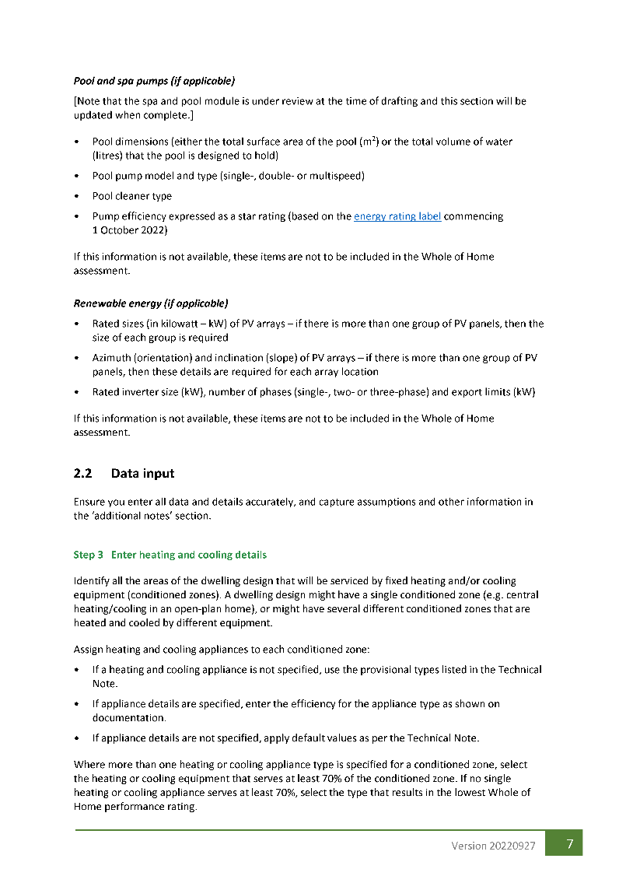
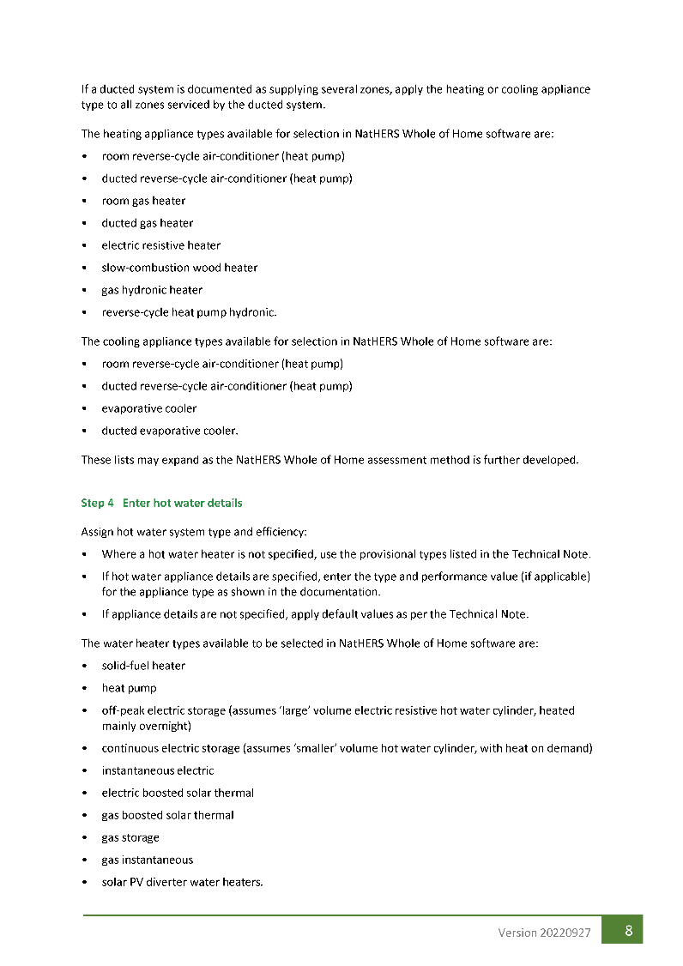

Slide 17
Who can undertake a WoH assessment?
Accredited WoH Assessor
Undertake WoH tool training
Complete this WoH Technical webinar
Complete the WoH Technical quiz
Provide certificate to your AAO
Non-accredited Assessor
Undertake WoH tool training
Complete this WoH Technical webinar
Complete the WoH Technical quiz

Slide 18
Example

Slide 19
Case study
NatHERS Example 4 drawing set https://www.nathers.gov.au/sites/default/files/2022-12/NatHERS%20Example4_drawings.pdf

Slide 20
Heating and Cooling Appliances

Slide 21
Heating appliances
The Whole of Home assessment tools will allow selection from the following heating appliances:
Non-ducted
heat pump
air-conditioner
Ducted
heat pump
air-conditioner
Electric resistive heater
Non-ducted
gas heater
(space heater)
Ducted
gas heater
Wood heater
Correct sizing for the dwelling is very important

Slide 22
Cooling appliances
The Whole of Home assessment tools will allow selection from the following cooling appliances:
Non-ducted
air-conditioner
Ducted
air-conditioner
Evaporative
cooler
No delineation between reverse cycle and cooling-only air-conditioners

Slide 23
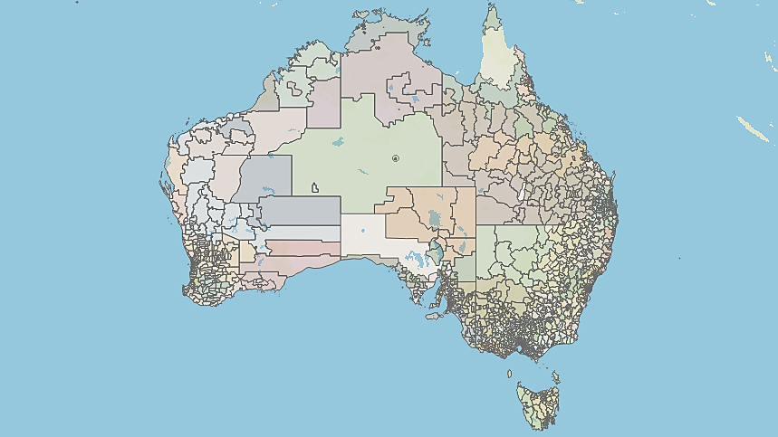
Key concepts
Hot and Humid
Same 69 NatHERS Climate Zones
Mixed
Cold

Slide 24
Technical Note requirements

Slide 25
Technical Note requirements

Slide 26
Technical Note requirements

Slide 27
Technical Note requirements

Slide 28
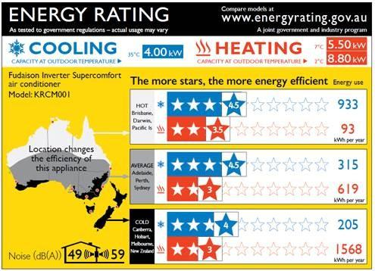
Data required for the WoH assessment
How zone is heated and cooled
Details of appliance
Climate type (zone)
Energy usage
Star rating

Slide 29
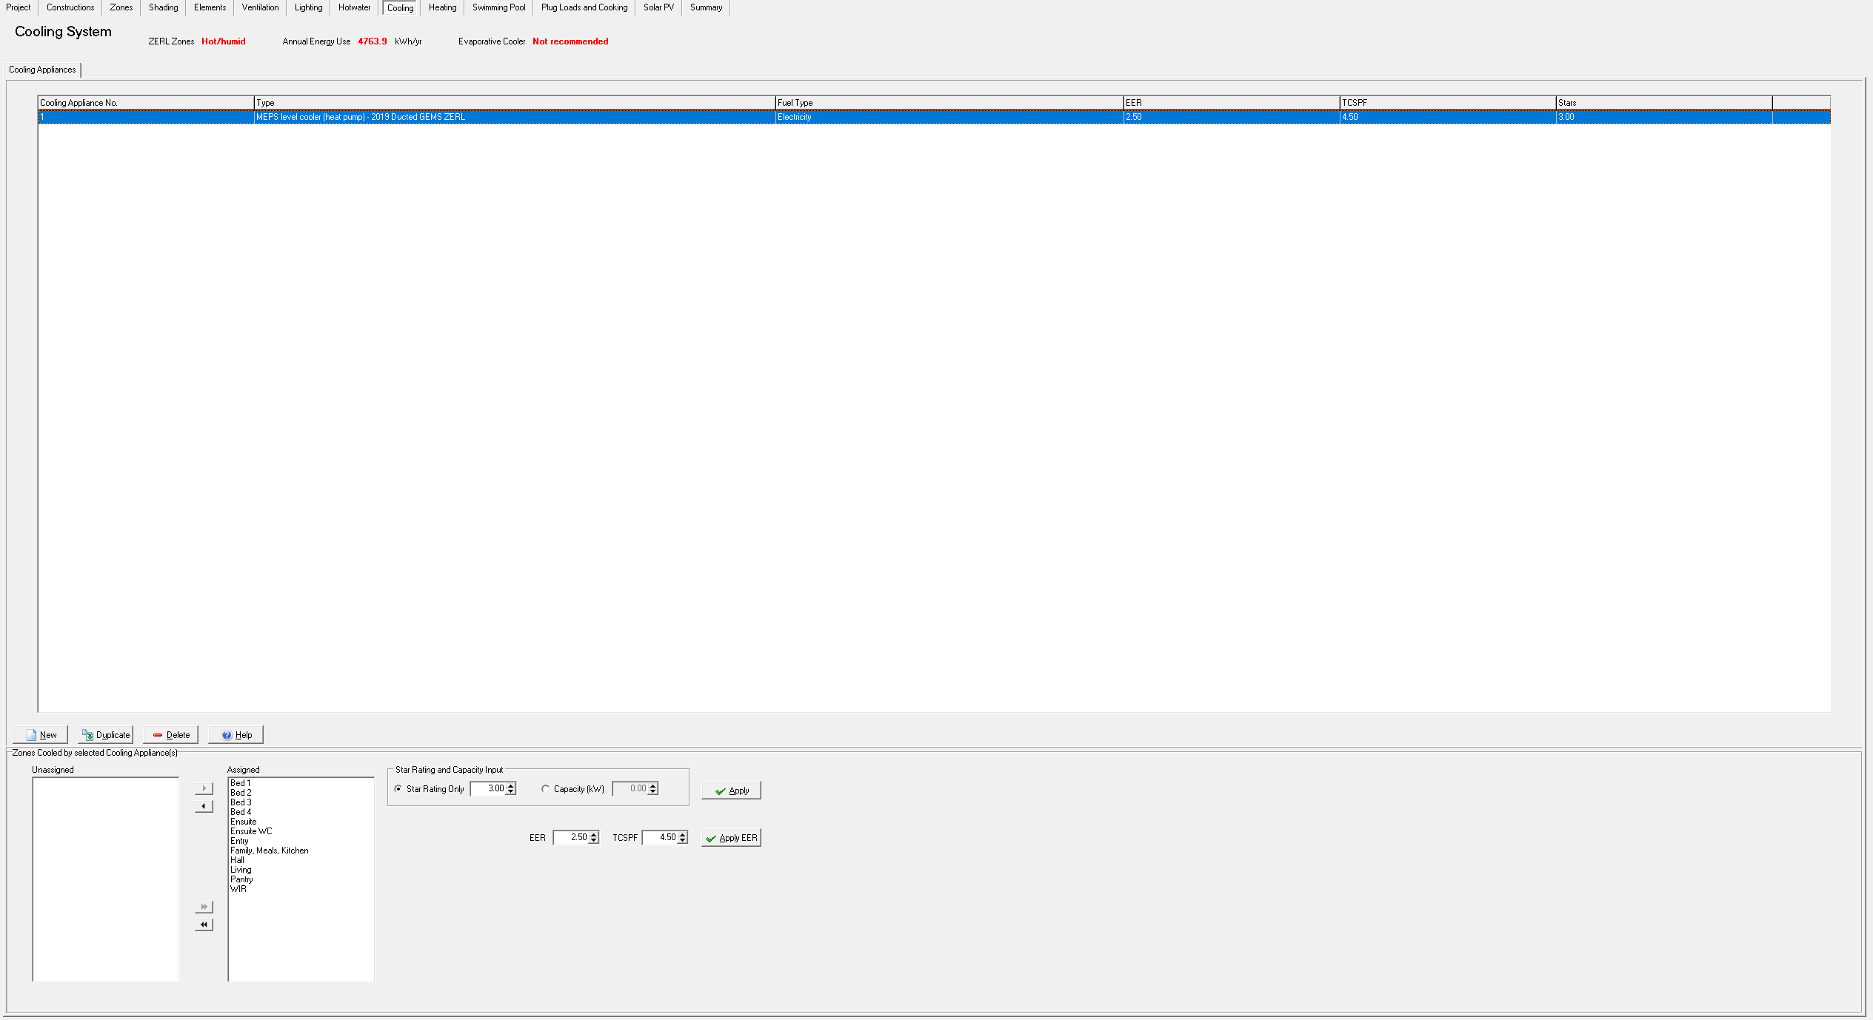

Slide 32
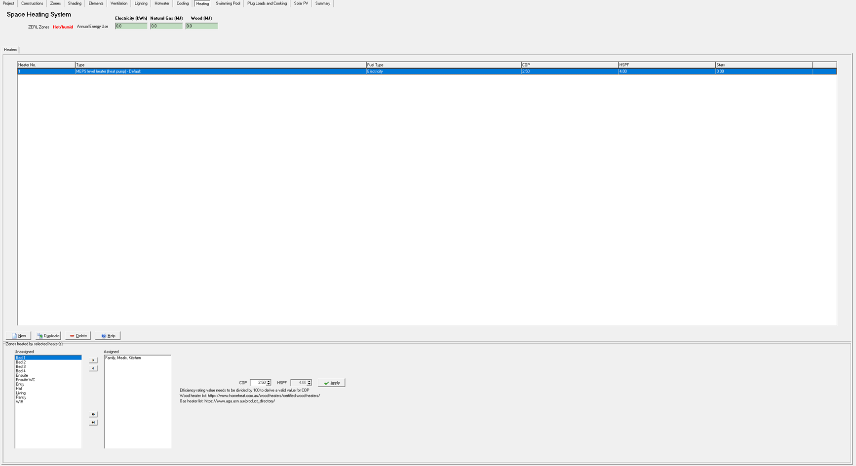

Slide 35
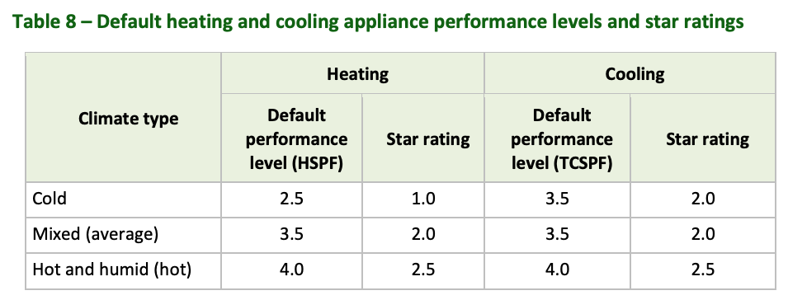
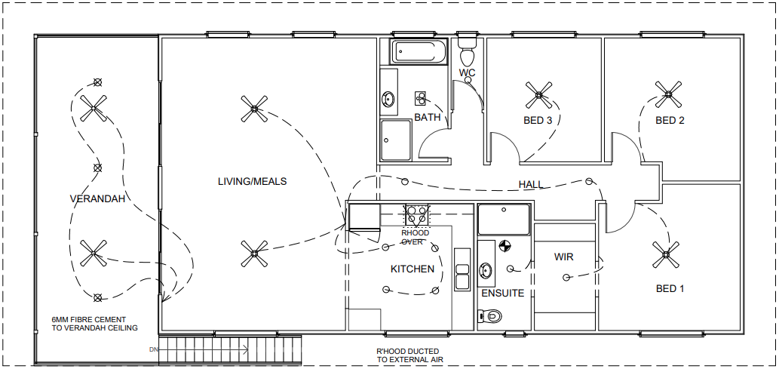
Heating and cooling appliance case study
assessment..

Slide 36
Hot Water

Slide 37
Key concepts
Types of water heaters
Solid fuel
Off-peak electric
Continuous
electric
Solar thermal
(electric boosted)
PV Diverters
Instantaneous
electric
Solar thermal
(gas boosted)
Heat pump
Gas storage
Gas
instantaneous

Slide 38
Key concepts
Small-scale Technology Certificates (STC)
Equal to 1 megawatt hour of renewable electricity either generated or displaced by eligible small-scale renewable energy systems such as solar PV, wind and hydro and solar water heaters and air source heat pumps

Slide 39
Technical Note requirements

Slide 40
Technical Note requirements

Slide 41
Technical Note requirements

Slide 42
Technical Note requirements

Slide 44
Technical Note requirements

Slide 45
Technical Note requirements

Slide 46
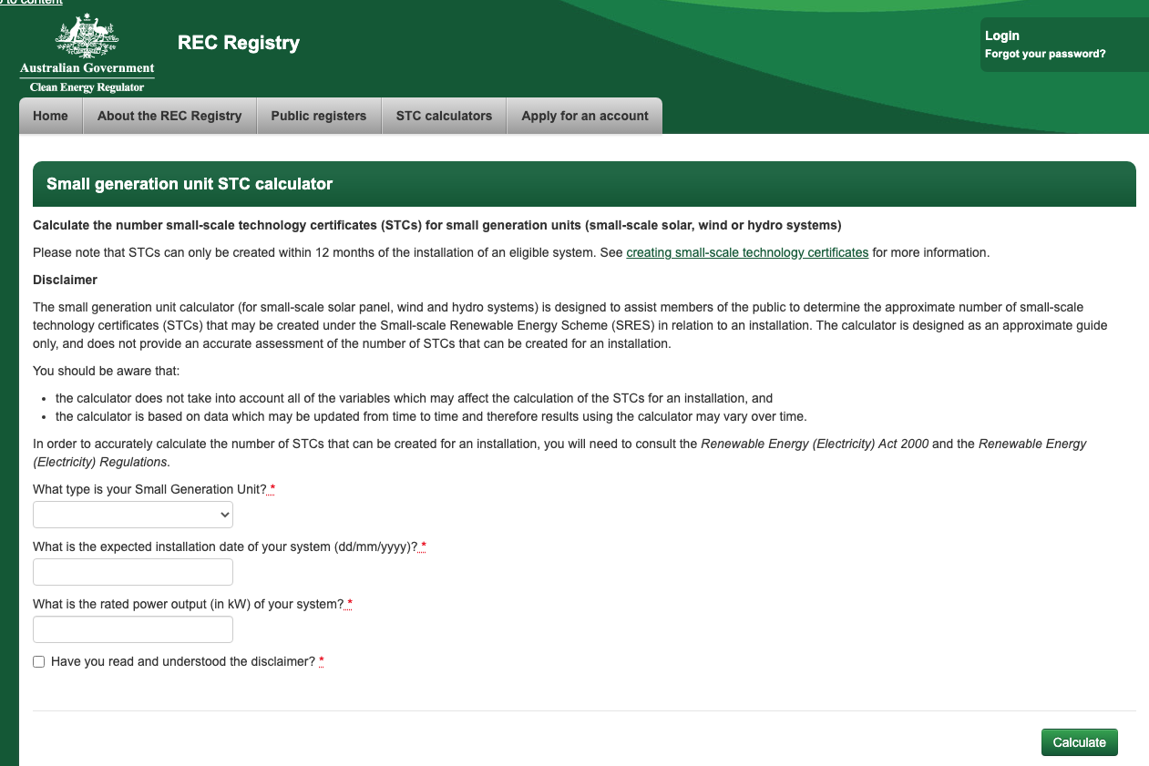

Slide 48
Data required for the WoH assessment
Hot water system specified
Type of diverter system if PV diverter
STC value

Slide 49
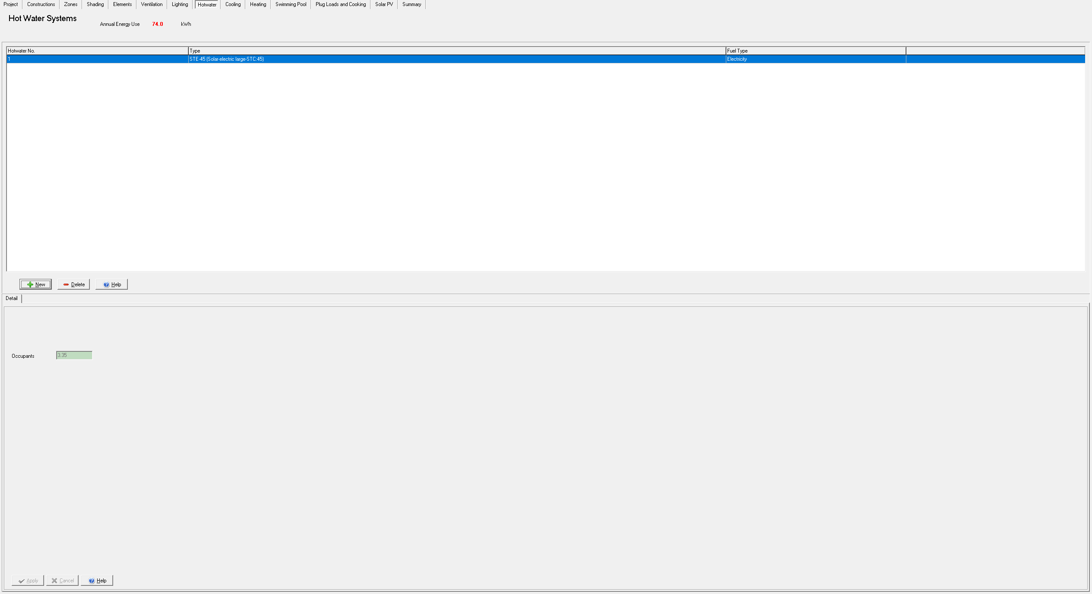

Slide 51
Hot water case study
No water heating system specified
Default values must be used
No gas outlet or appliance
specified
Must use
Electric
storage
hot water
off-peak

Slide 52
Lighting

Slide 53
Key concepts
Lighting power density represents the load of lighting equipment in a specified area. Typically represented as Watts per square metre (W/m²).
CFL
CFL
LED
Linear and
Circular
fluorescent
Halogen
Halogen
Source: https://www.yourhome.gov.au/energy/lighting

Slide 54
Technical Note requirements

Slide 55
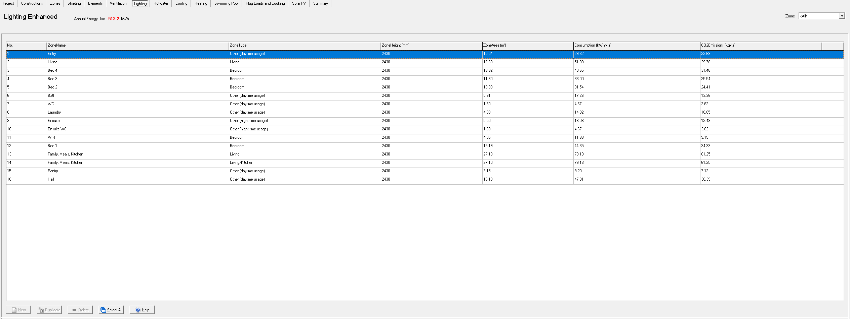
Data required for the WoH assessment
Lighting power density (in W/m2)

Slide 56
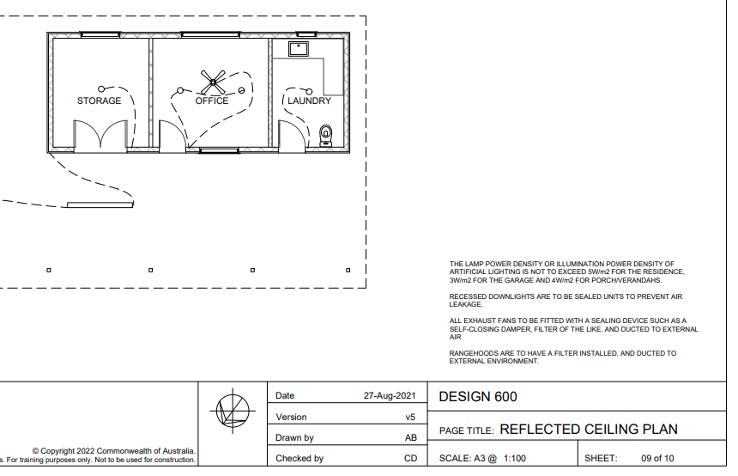
Lighting case study

Slide 57
Pools and Spas

Slide 58
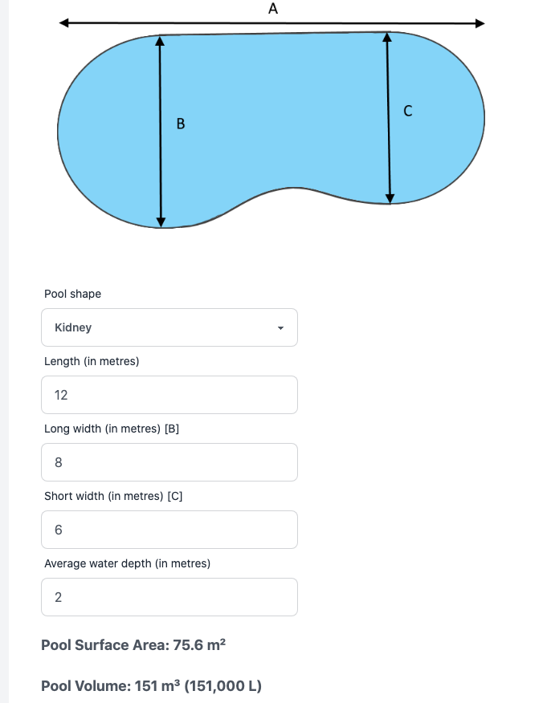
Key concepts
Pool volume
(m³)
Pool
surface area
(m²)
Pool
pump type
Pool
cleaning
system type

Slide 59
Technical Note requirements

Slide 60
Technical Note requirements

Slide 61
Technical Note requirements

Slide 62
Data required for the WoH assessment
Pool or spa
volume or
surface area
Pool or spa
pump type
Pump
Star rating
(2019 GEMS)
Water
cleaning
system type

Slide 63
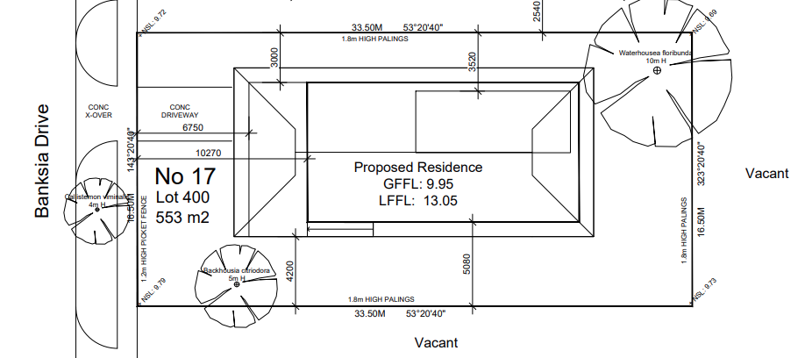
Pool and spa case study
No pool or spa is specified

Slide 66
On-Site Renewable Energy

Slide 67
Key concepts
PV system size
(kW)
Inverter
capacity
of arrays or
strings
Panel
inclination
(angle)
Panel
direction
(orientation)

Slide 68
Technical Note requirements

Slide 69
Technical Note requirements

Slide 70
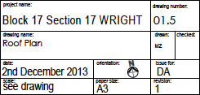

Slide 71
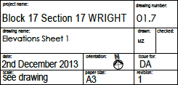

Slide 72
Technical Note requirements

Slide 73
Data required for WoH assessment
PV system size
(kW)
Inverter
capacity
of arrays or
strings
Panel
inclination
(angle)
Panel
direction
(orientation)

Slide 74
On-Site Renewable Energy case study
No renewable energy generation is specified

Slide 77
On-Site Energy Storage

Slide 78
Key concepts
Battery types
Lithium-ion
Lead acid
Zinc bromine

Slide 79
Technical Note requirements

Slide 80
Data required for WoH assessment
Battery type
Battery size

Slide 81
On-Site Energy Storage case study
No battery is specified

Slide 82
Plug Load and Cooking Loads

Slide 83
Key concepts
Plug load
Cooking load

Slide 85
Technical Note requirements

Slide 86
Data required for WoH assessment
Energy sources for cooking appliances
Electric oven
Gas cooktop
Induction cooktop
Electric cooktop

Slide 87
Plug Load and Cooking Loads case study
assessment..

Slide 88
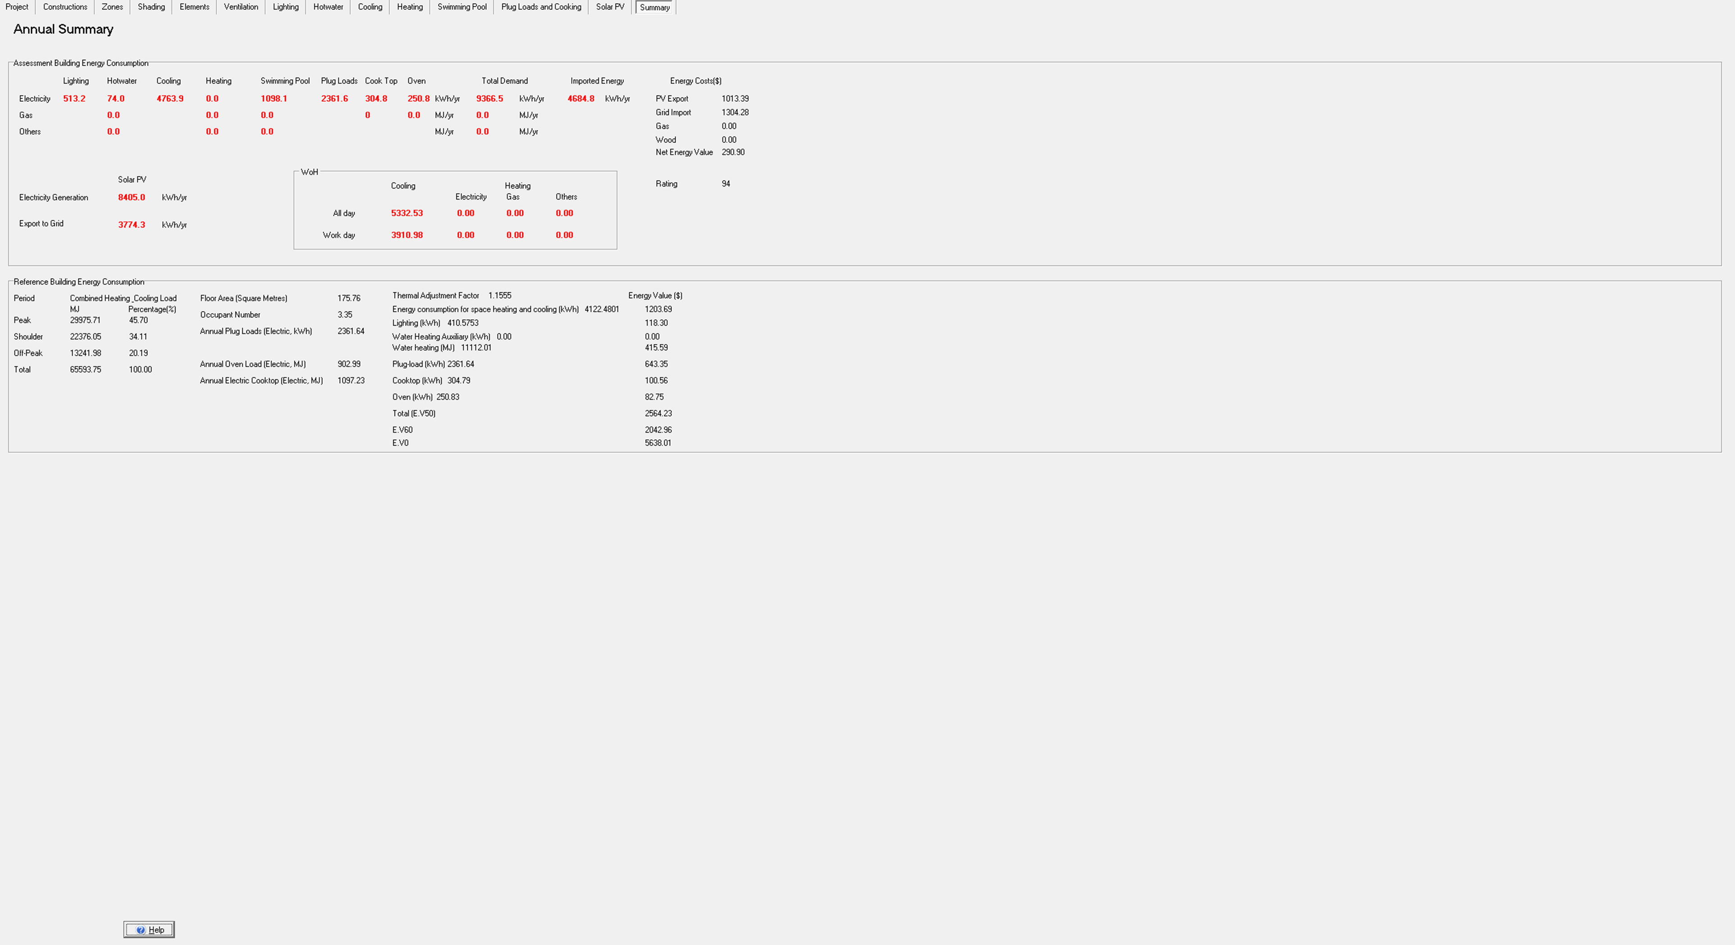

Slide 90
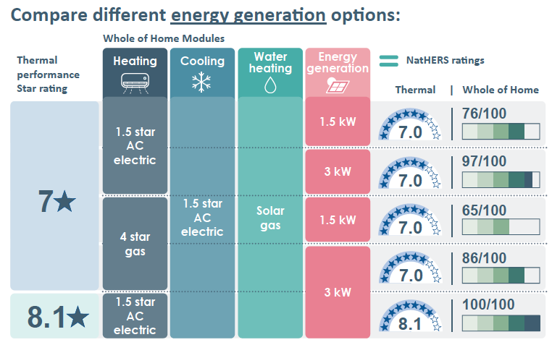
Example – Melbourne

Slide 91
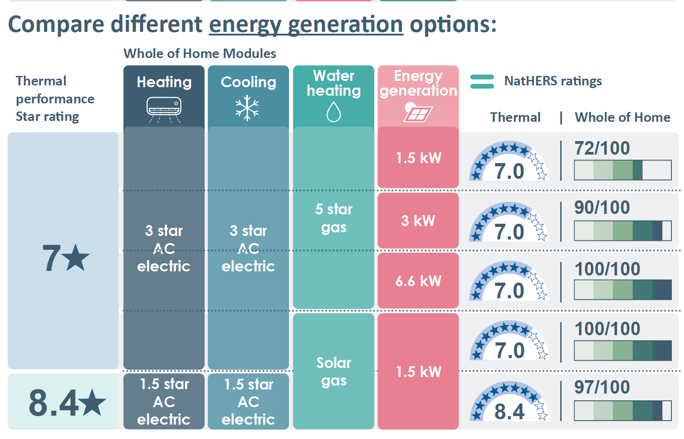
Example – Brisbane

Slide 92
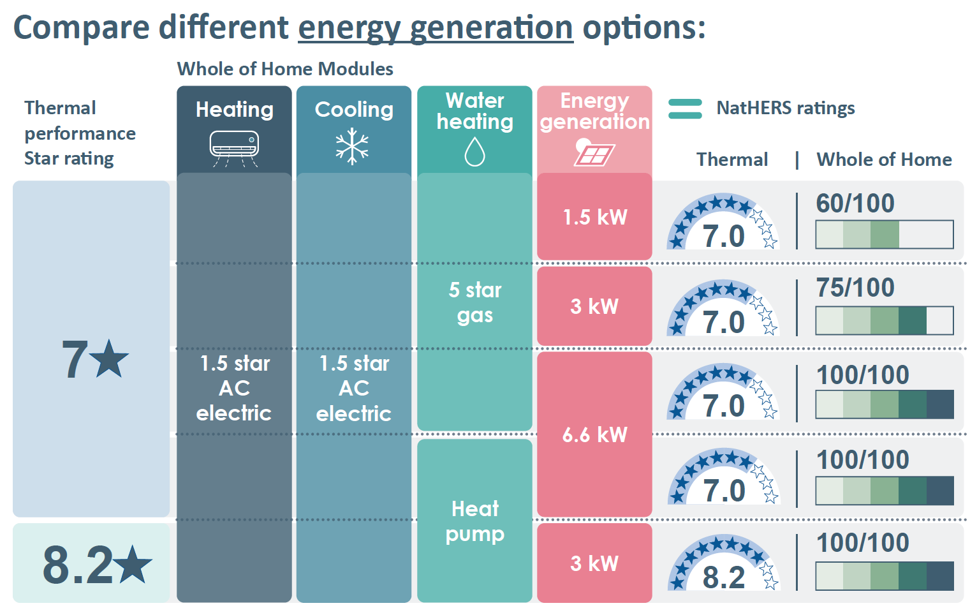
Example – Canberra

Slide 93
Summary
In this webinar we have covered:
Overview of Whole of Home
Undertaking a Whole of Home Assessment
Heating and Cooling Appliances
Hot Water
Lighting
Pools and Spas
On-Site Renewable Energy
On-Site Energy Storage
Plug Loads and Cooking Loads

Slide 94
Questions?

Slide 95
Complete the Quiz
Access and complete the quiz at:
https://transformed-pty-ltd-short-courses.thinkific.com/courses/nathers-whole-of-home-technical
You will need to register

