Slide 1


NatHERS Whole of Home
Overview
Presenter(s): Michael Young
Date: 8 August 2023
DCCEEW.gov.au

Slide 2

Source: Barramundi, Aboriginal x-ray art. Photo: Jon Connell. Creative Commons BY 2.0 (cropped)

Slide 3
Scope
In this webinar we will cover:
Overview of Whole of Home
Benefits of Whole of Home
Appliances included in Whole of Home
How to find energy efficiency information for appliances
How a Whole of Home Assessment is Conducted
Whole of Home Certificate
How do I improve my Whole of Home Rating?
Questions

Slide 4
Disclaimer
This webinar DOES NOT cover any software or tool. Please speak with software developers to learn about the timings for the release of their Whole of Home product and for training in the use of that tool.

Slide 5
Overview of NatHERS Whole of Home

Slide 6
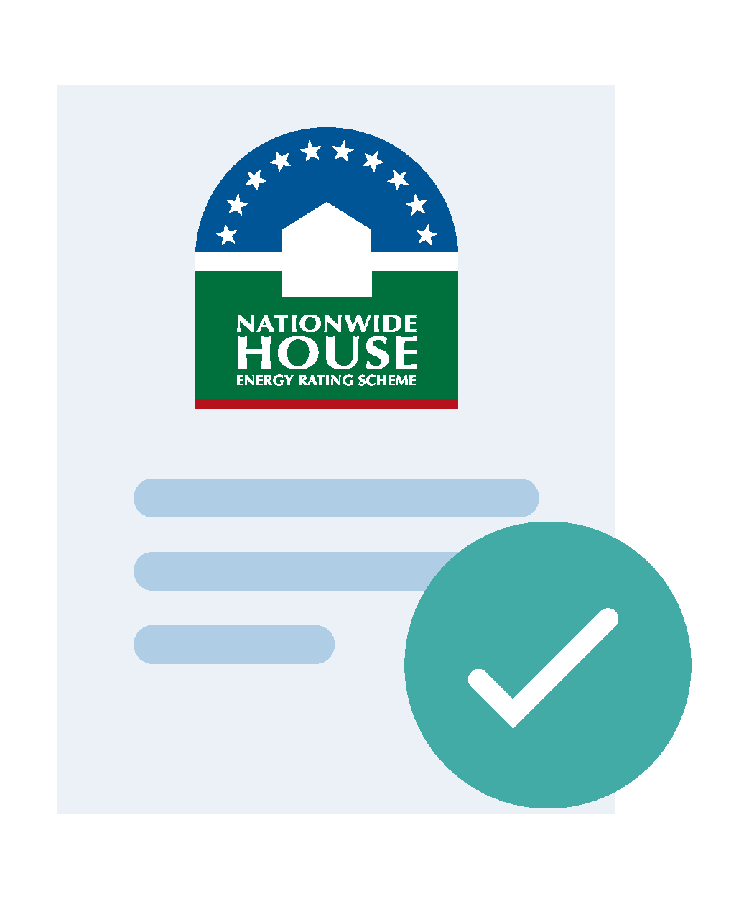




Slide 7
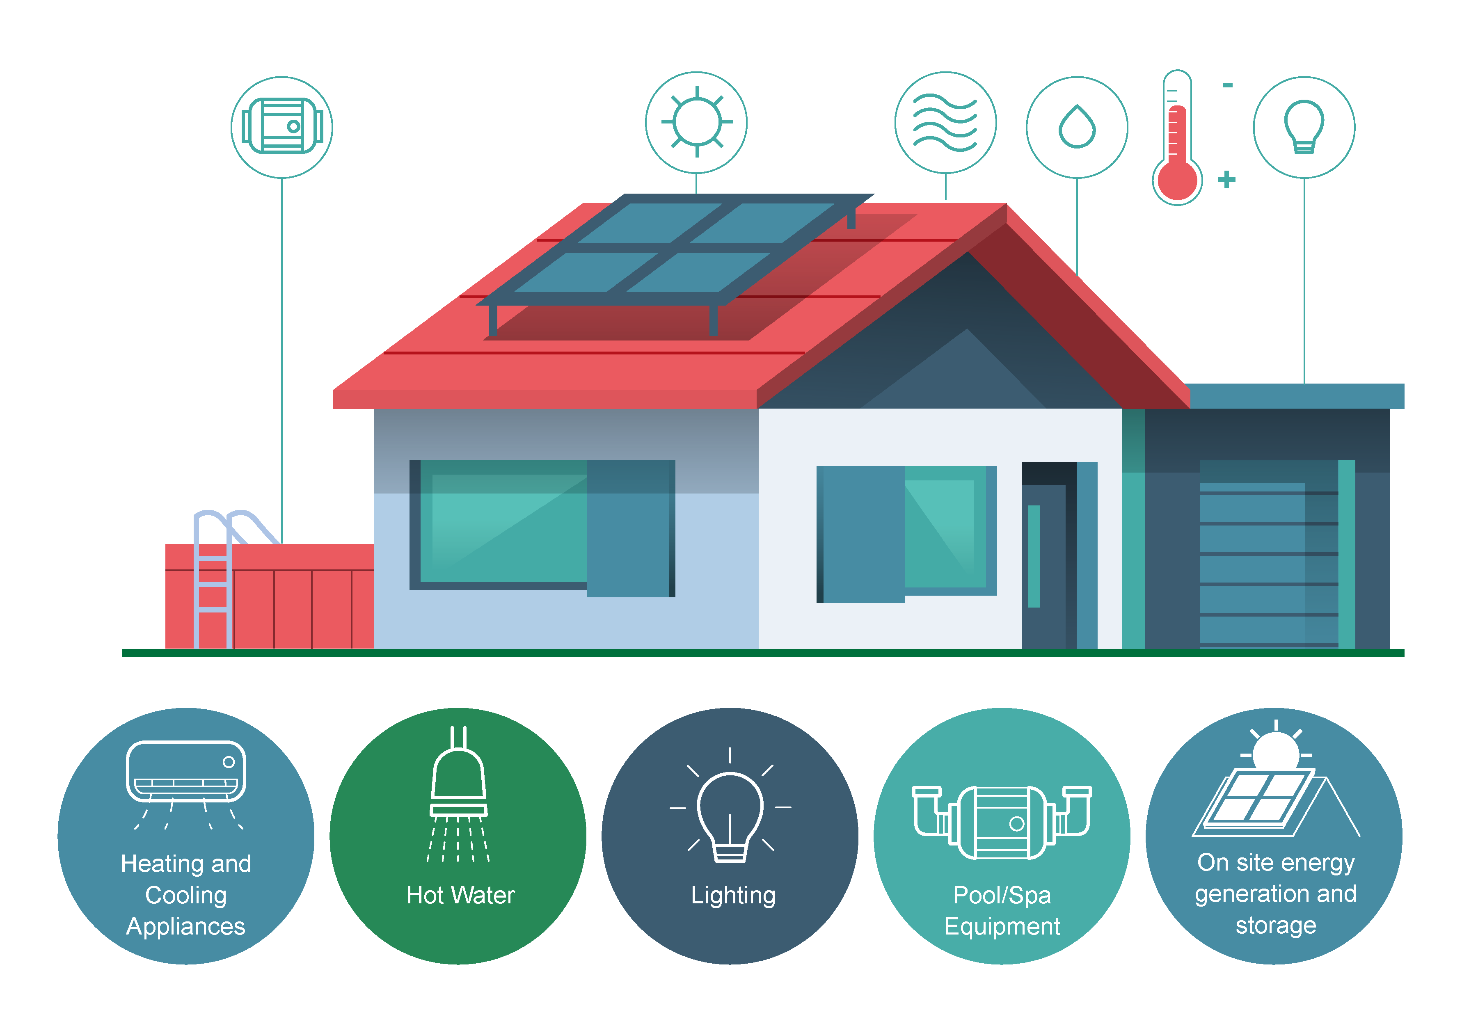

Slide 8
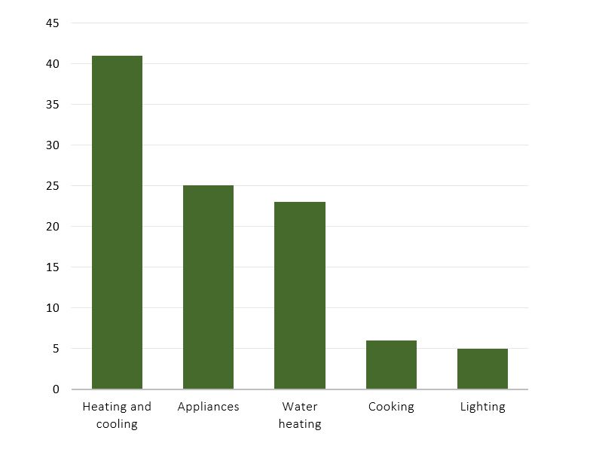
Energy Use
Source: https://www.yourhome.gov.au/energy/heating-and-cooling

Slide 9
Energy Value
Energy value is the net cost to society of energy use, including costs to the building user, the environment and energy networks
It is a measure of the dwelling’s energy performance
Two main factors affect the energy value of any given unit of energy consumed:
  Fuel type
  Time of use

Slide 10

Energy Value
The lower the energy value of the modelled energy loads in the assessment, the higher the Whole of Home performance rating.

Slide 11
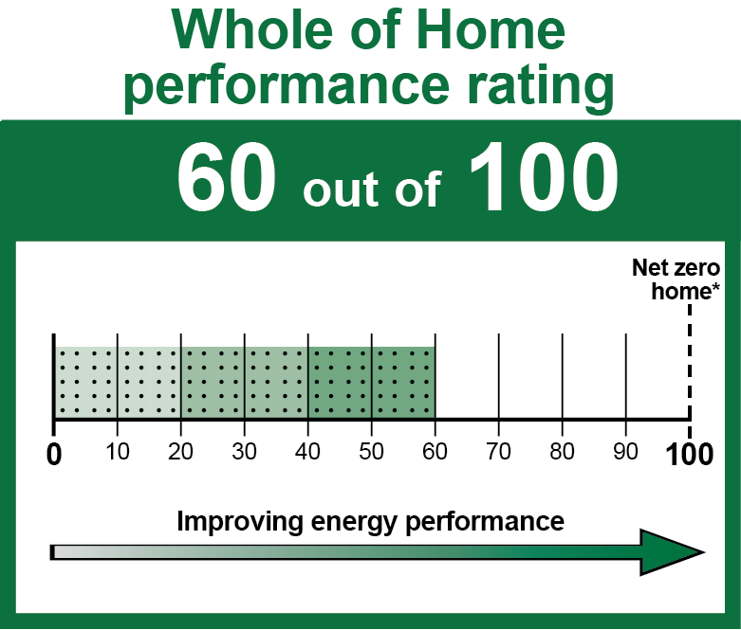
Reference Dwelling
The performance rating is calculated based on how the assessed dwelling performs compared with a reference dwelling
A score of 50 means that the dwelling design has the same performance as the reference dwelling

Slide 12
Reference Dwelling
The reference dwelling has the following characteristics:
7 Star thermal shell
3 Star ducted heat pump
5 Star
instantaneous
gas hot water
4W/m² lighting power density
No
spa or pool
No onsite
energy
production
or storage
Reverse-cycle air-conditioning
For heating and cooling

Slide 13




Whole of Home software
Assessors must use NatHERS-accredited software to obtain certification of a NatHERS assessment. The four accredited software tools are:
AccuRate
BERS Pro
FirstRate5
Hero
All new assessments are to be undertaken using the latest version of the chosen software unless an exemption is provided by the relevant building authority.
The software must be accredited for a Whole of Home assessment.

Slide 14
What you can’t change
For Whole of Home this includes:
  The thermal shell elements
  Same thermal shell must be used for the Star Rating and the Whole of Home rating
Can still revisit the thermal shell performance, but a new whole of home simulation will be required for the certificate
Occupant behaviour
Efficiency of general plug loads

Slide 15
Benefits of Whole of Home

Slide 16
Benefits of Whole of Home
Expanding NatHERS to include Whole of Home helps:
Reduce
energy bills
Reduce
carbon emissions
Improved
thermal
comfort
Design
beyond
minimum
standards
Achieve
zero energy
(and carbon)
ready home
Consumers
Industry and Consumers

Slide 17
Benefits of Whole of Home
Support a range of different initiatives, such as the finance sector being able to use NatHERS to underpin their products
Cater for potential future energy efficiency requirements in the National Construction Code

Slide 18

Benefits of expanding NatHERS
Supports a variety of programs
Delivers harmonised outputs
Allows a choice of tools to be accredited that can suit different users
Uses science and Australian data
Requires assessors use the home energy rating tools in consistent ways
Ensures consistent data
National administrative processes
Delivery by both government and commercial entities
National governance

Slide 19
Appliances included in Whole of Home

Slide 21
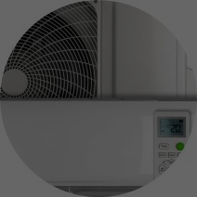


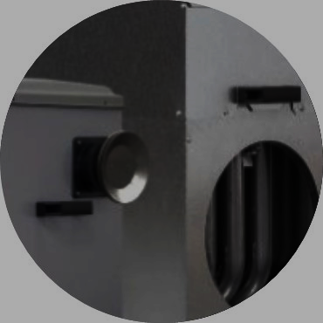

Heating appliances
The Whole of Home assessment tools will allow selection from the following heating appliances:
Non-ducted
heat pump
air-conditioner
Ducted
heat pump
air-conditioner
Electric resistive heater
Non-ducted
gas heater
(space heater)
Ducted
gas heater
Wood heater
Correct sizing for the dwelling is very important

Slide 22
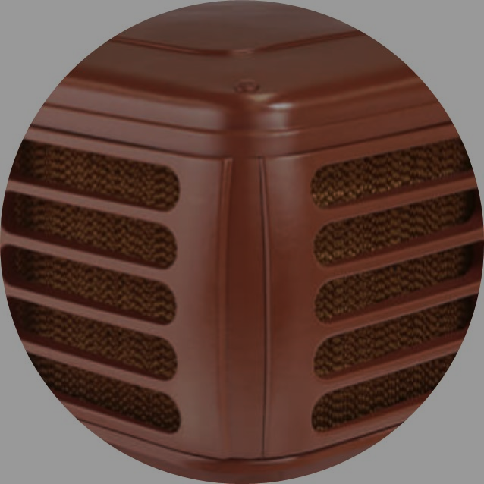
Cooling appliances
The Whole of Home assessment tools will allow selection from the following cooling appliances:
Non-ducted
air-conditioner
Ducted
air-conditioner
Evaporative
cooler
No delineation between reverse cycle and cooling-only air-conditioners

Slide 23

Cooling appliances
The tools allows each cooling appliance to be allocated to one or multiple rooms or zones of the home.
Evaporative coolers can only be selected for use in appropriate NatHERS climate zones​.

Slide 24
Water heating appliances
Water heating
Kitchen

Slide 25
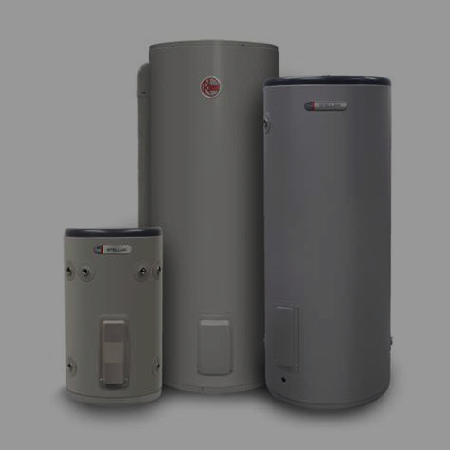
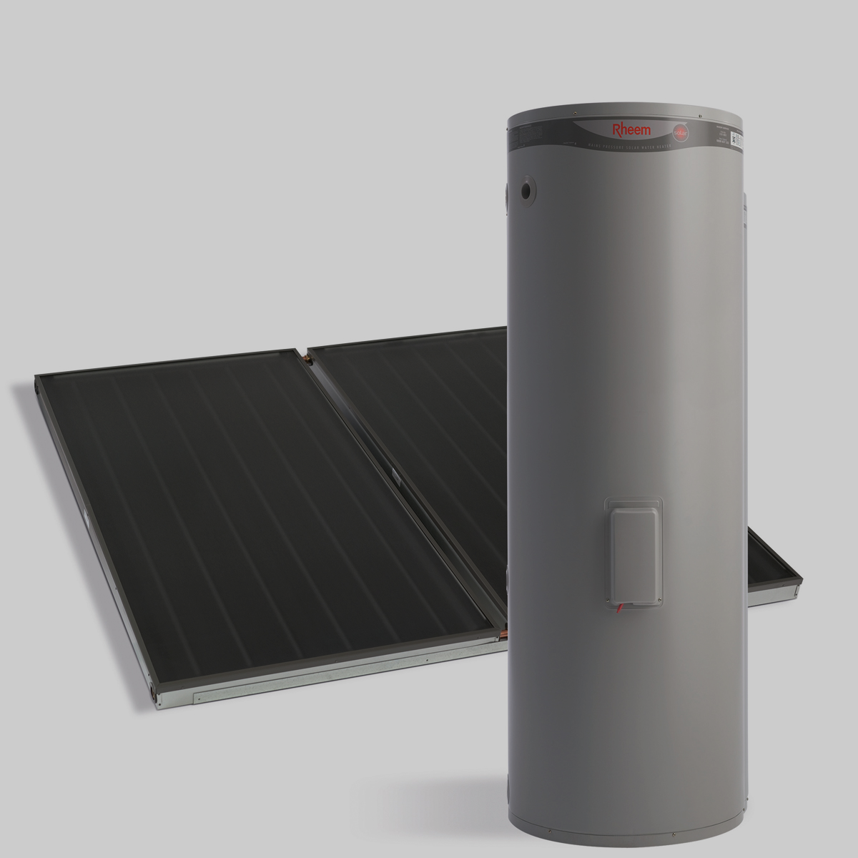
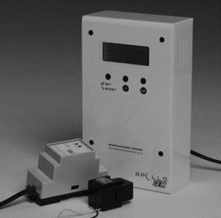
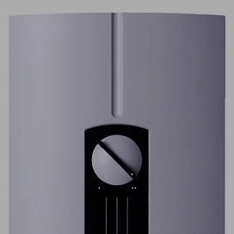
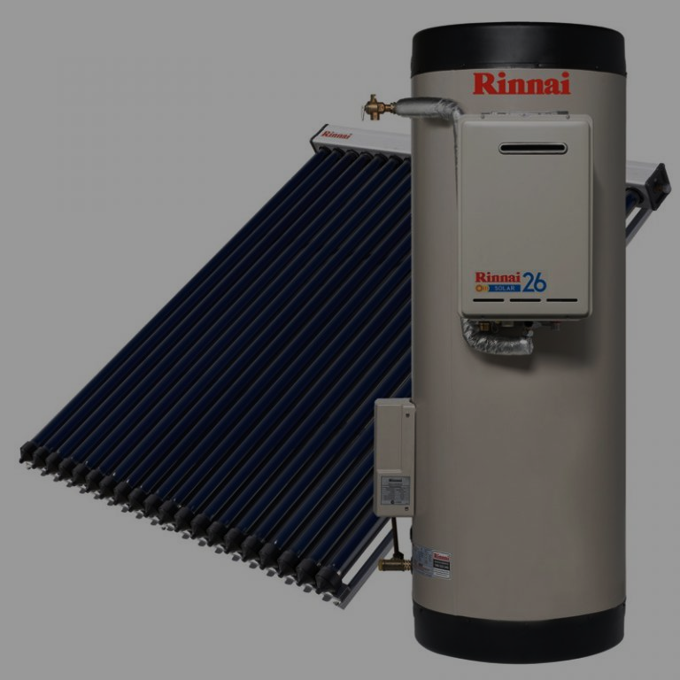
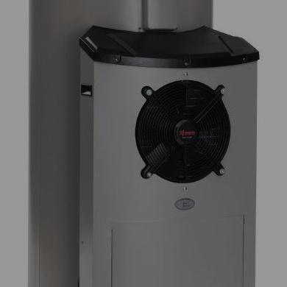
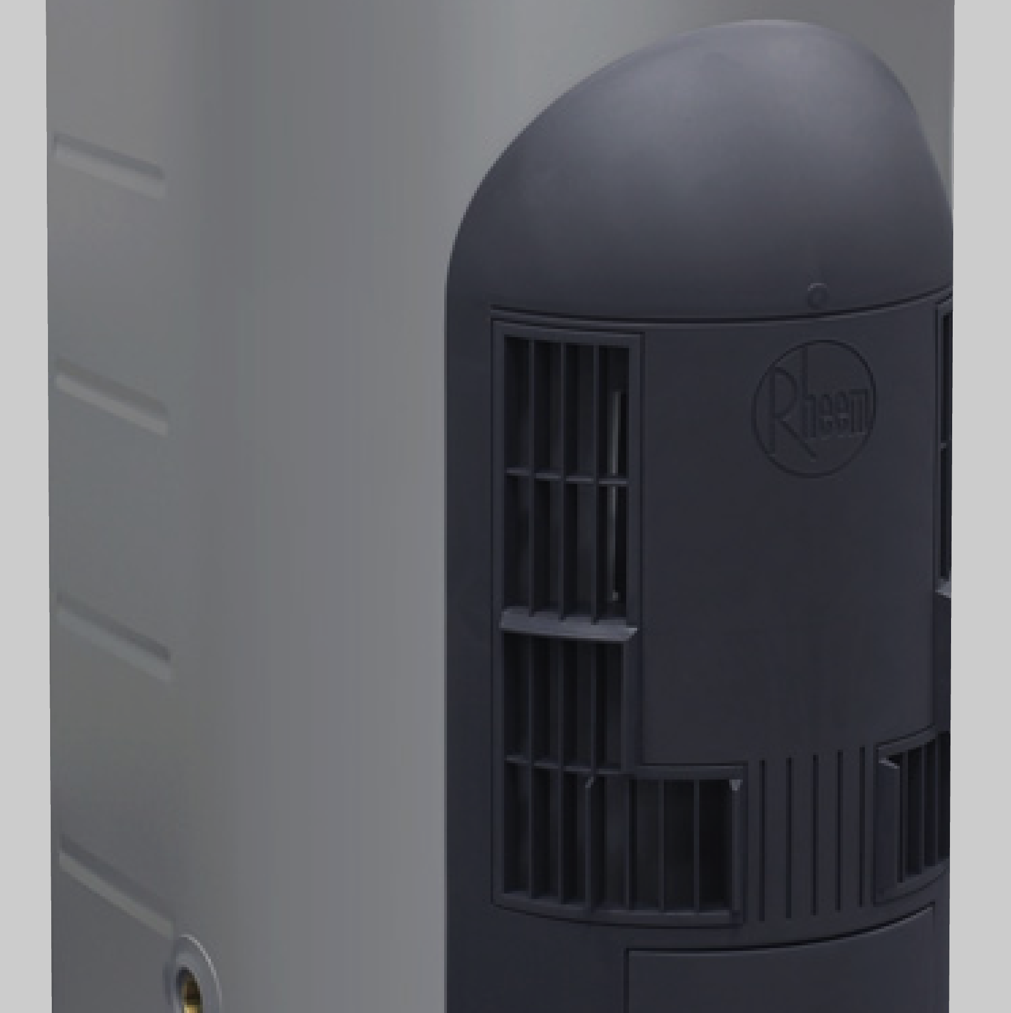

Water heating appliances
Whole of Home assessment tools will include the following water heating appliances:
Off-peak electric
Continuous
electric
Solar thermal
(electric boosted)
PV diverters
Instantaneous
electric
Solar thermal
(gas boosted)
Heat pump
Gas storage
Gas
instantaneous
Solid fuel

Slide 26
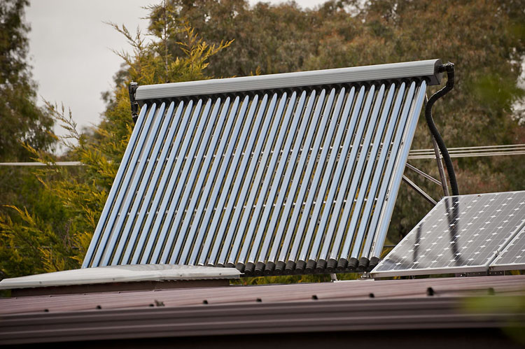
Water heating appliances
The choice may also be limited by available energy sources:
Solar access and adequate north facing roof space must be available if a solar hot water system is to be installed.
Natural gas is not available in some areas.

Slide 27
Lighting
Energy consumption for artificial lighting is calculated automatically by the software - based on the floor area of the building and a standard assumption for lighting efficiency and use.
Assumes that the building complies with any lighting provisions in the construction code.
A NatHERS certificate is not proof that the design has met the minimum lighting provisions in the NCC.
NatHERS tools are not ‘lighting calculators’ and cannot be used to determine lux levels in the building.
A new home or renovation must meet the energy consumption requirements of the NCC.

Slide 28




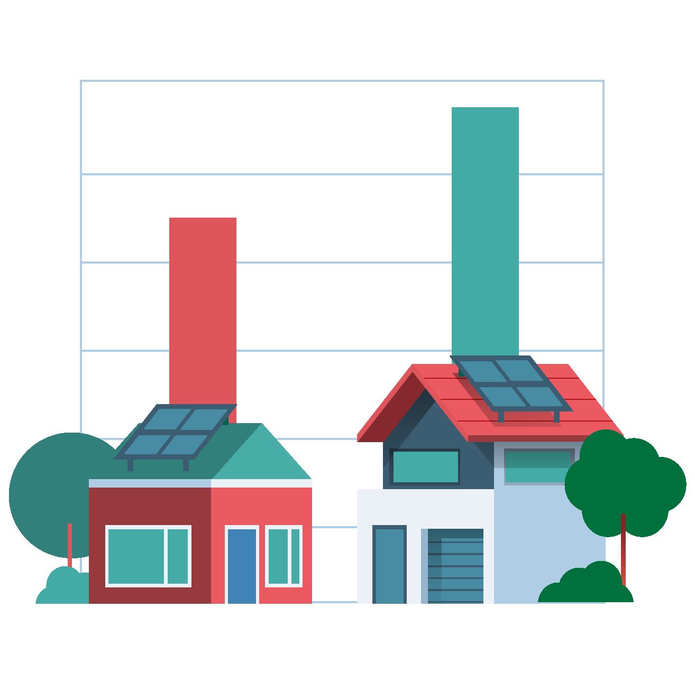
Onsite Energy Generation and Storage
12-16%
Multi & mono crystalline cells
Amorphous silicon & thin film PV
5-9%

Slide 29
Onsite Energy Generation and Storage
A 1.5 kilowatt system would provide about 25% of the electricity needs for a family of four with average energy consumption.
Whole-of-Home assessment tools include solar PV and a battery option based on the Victorian Zero Net Carbon method.
A shading factor is built into the model to account for overshadowing objects:
  no shading,
  medium shading
  high shading

Slide 30

Onsite Energy Generation and Storage
The assessment requires:
slope of the panels,
the size of the system,
the direction the system faces and,
the time zone to be inputted.

Slide 31

Swimming Pool and Spas Pumps
Filtration is 70 – 90% of pool electricity use
Pool pumps can also perform other functions:
  running spa jets,
  water features, or
  high-pressure cleaning systems.
Pool volume or surface area is entered into the tool

Slide 32
Swimming Pool and Spas Pumps
Pool pump options in Whole of Home are:
  Single Speed
  Dual-speed
  Multi-speed
There are three pool cleaning pump options available:
  Pressure Cleaner with Main Filtration Pump
  Pressure Cleaner with Booster Pump
  Robotic system
A standard assumption of pump efficiency is applied.

Slide 33
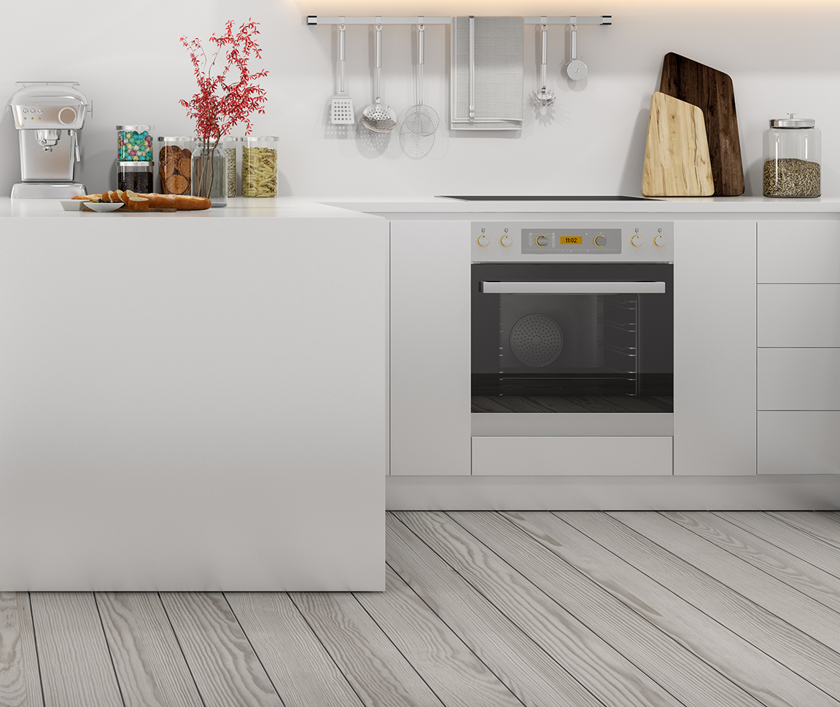
Cooking appliances
Cooktop:
  Gas
  Electric
  Induction
Oven:
  Electric
  Gas

Slide 34
How to find energy efficiency information for appliances

Slide 35
Appliance energy labels
The Energy Rating Label shows the energy efficiency and
energy consumption of rated products allowing comparison of running costs over the life of the product.

Slide 36
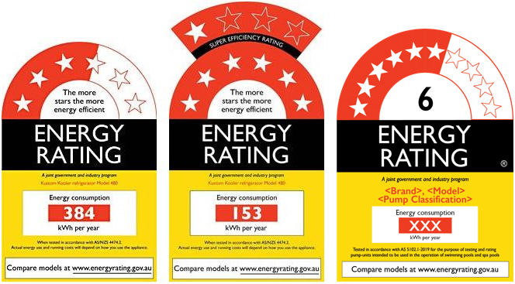
Energy rated appliances

Slide 37
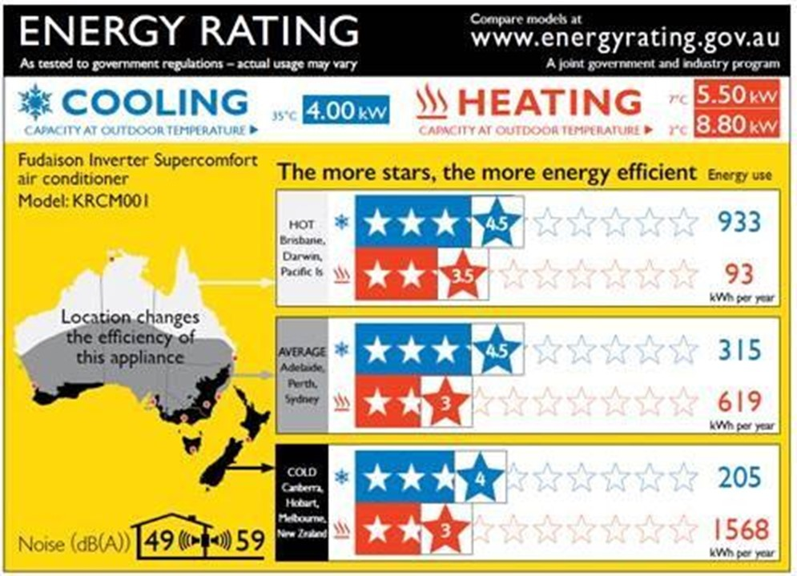
Energy rated appliances

Slide 38

Natural gas appliances

Slide 39
Energy rating
The Equipment Energy Efficiency (E3) Program helps improve the
energy-efficiency of a range of appliances and equipment.
By buying more efficient models, households and businesses can:
  consume less energy,
  save money on their energy bills, and
  help to reduce emissions.

Slide 40
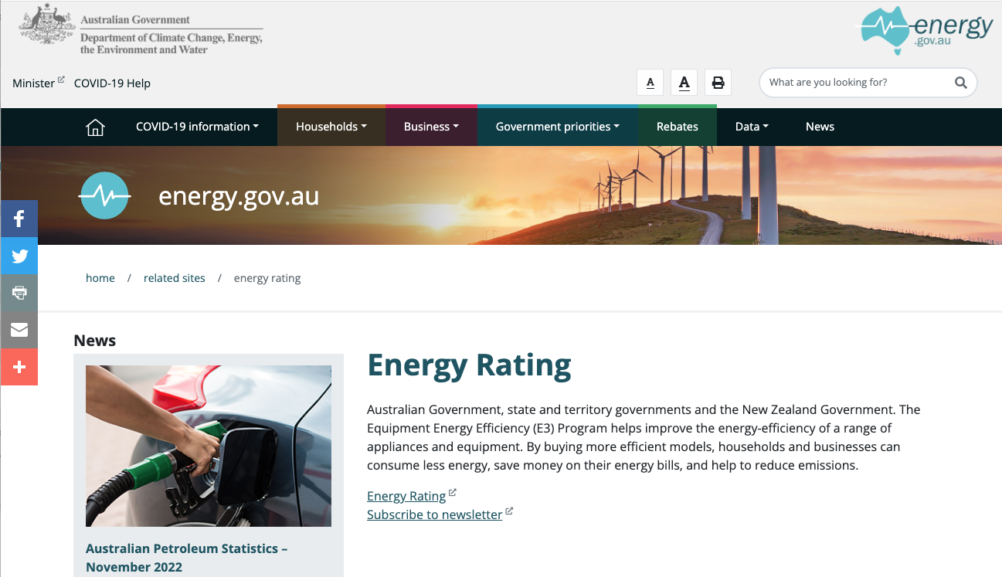
Where to find Appliance Energy Rating
www.energy.gov.au/energy-rating
https://reg.energyrating.gov.au/comparator/product_types/

Slide 41
How a Whole of Home Assessment is conducted

Slide 42
NatHERS assessment
The NatHERS Whole of Home assessment builds on the existing NatHERS thermal assessment that is used to verify compliance with the energy efficiency performance requirements of the NCC.
From 1 October 2023, there will be two energy efficiency performance requirements for residential buildings under the NCC:
  the thermal performance and,
  the energy usage performance.
A NatHERS assessment will verify compliance with both of these requirements:
  The thermal assessment and star rating will address thermal performance.
  The Whole of Home performance rating will address energy usage.

Slide 43


Other options
There are other options for demonstrating compliance with the NCC energy efficiency provisions:
an elemental method is also available in the NCC
In New South Wales, the BASIX tool is used in place of the NatHERS Whole of Home

Slide 44
The assessment process
1
Access a completed NatHERS thermal rating
2
Identify and collect information and documentation
3
Enter heating and cooling details
4
Enter hot water details
5
Enter lighting details
6
Enter spa and pool details (if applicable)

Slide 45
The assessment process continued
7
Enter onsite renewable energy details (if applicable)
8
Enter onsite energy storage details (if applicable)
9
Other notes and considerations
10
Run the Whole of Home calculation
11
Generate the NatHERS certificate and mini-certificate (stamp)
12
Stamp drawings and provide to client with the NatHERS certificate

Slide 46
Whole of Home Certificate

Slide 47
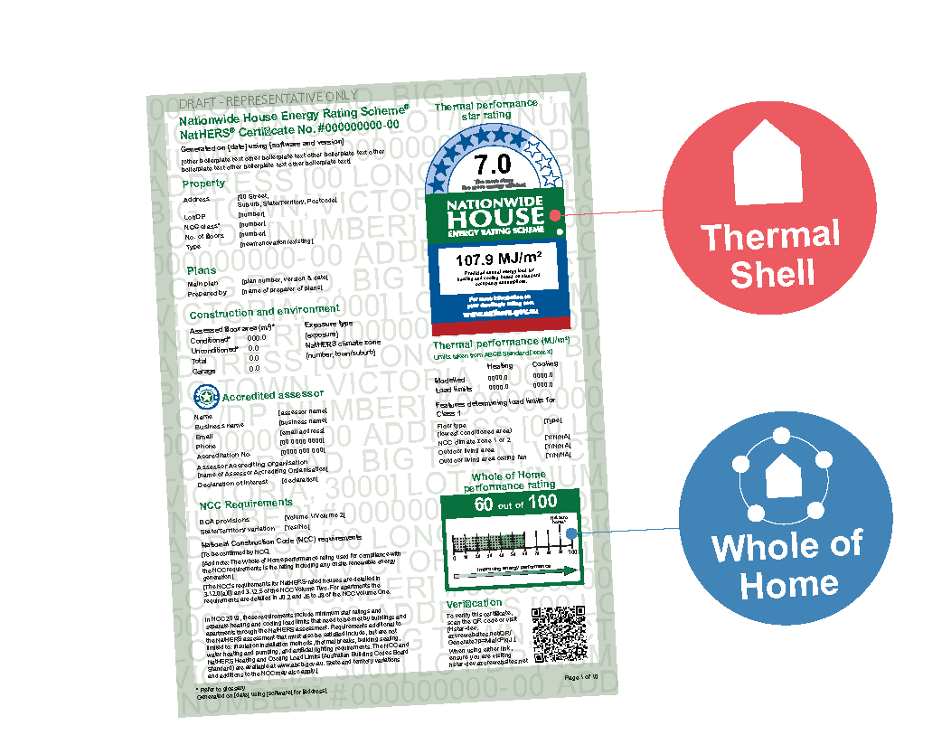

Slide 49
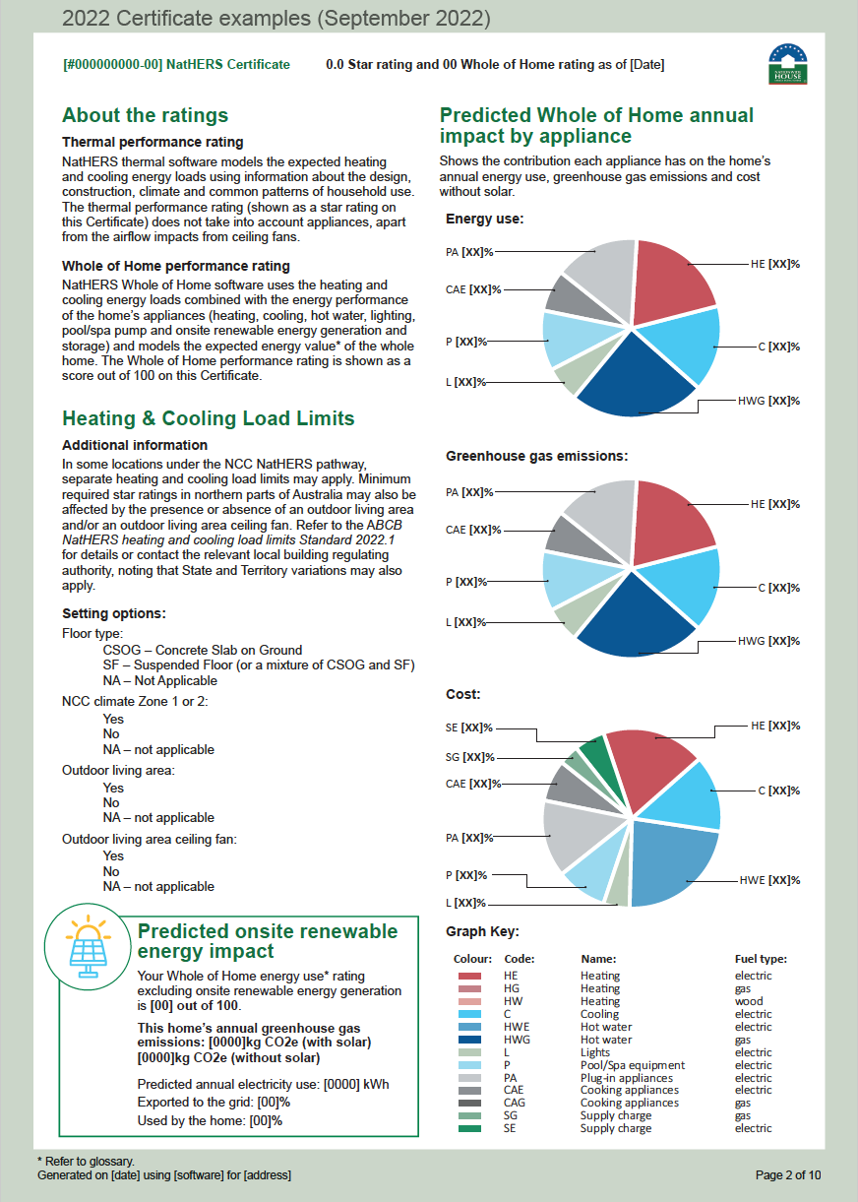

Slide 50
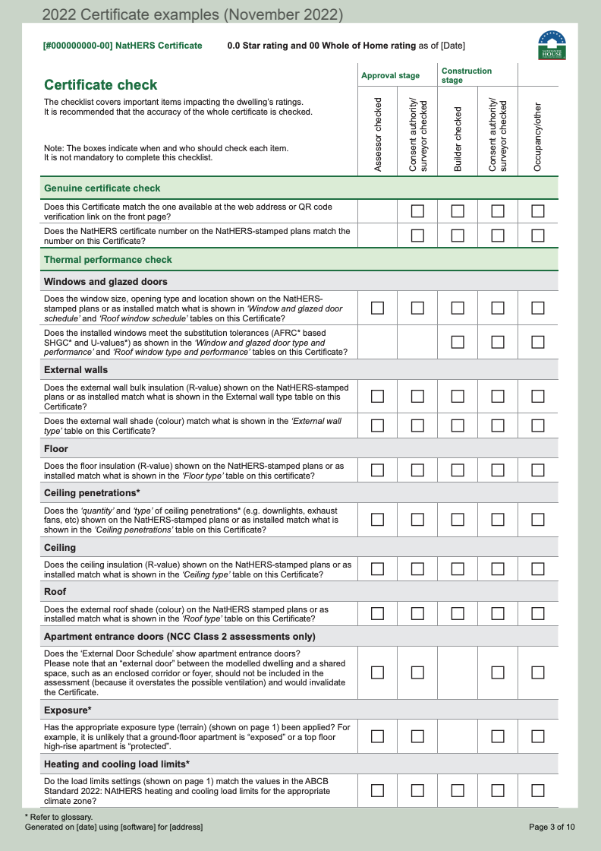

Slide 51
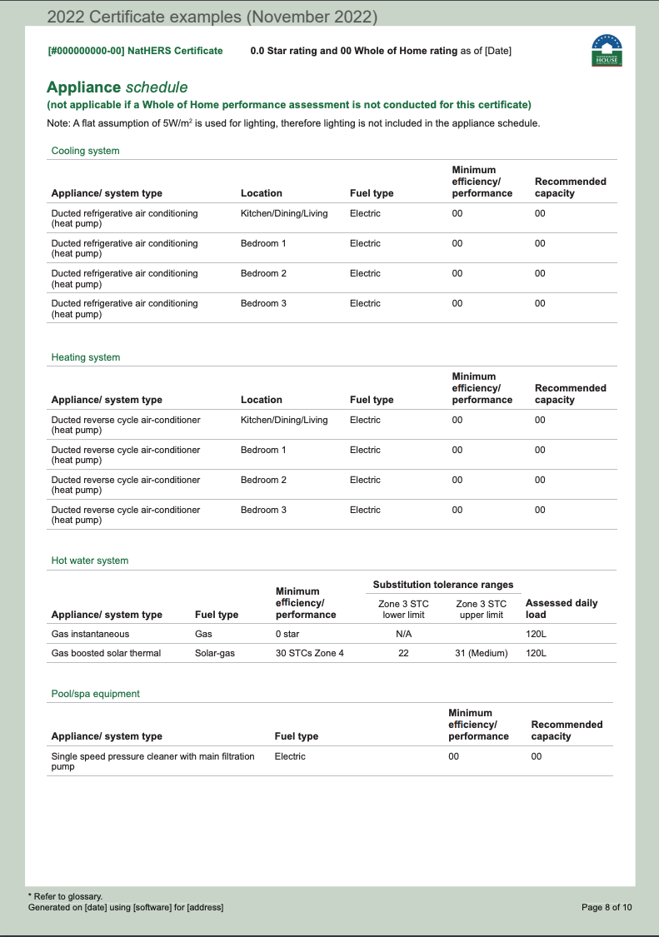

Slide 52
What should I use PowerPoint for?
Whole of Home Performance Rating

Slide 53
How do I improve my Whole of Home Rating?

Slide 54
How to improve the Whole of Home Rating
Go beyond a 7-star thermal shell
Use higher star rating appliances
Select different appliance
Use multiple non-ducted systems instead of single ducted system
Switching between fuels and technologies
Load shifting
Adding solar PV, or re-orienting solar PV to generate more energy during afternoon and evening peaks
Adding batteries

Slide 55
Summary
In this webinar we have covered:
Overview of Whole of Home
Benefits of Whole of Home
Appliances included in Whole of Home
How to find energy efficiency information for appliances
How a Whole of Home Assessment is Conducted
Whole of Home Certificate
How do I improve my Whole of Home Rating?

Slide 56
Complete the Quiz
Access and complete the quiz at:
https://transformed-pty-ltd-short-courses.thinkific.com/courses/nathers-whole-of-home-overview
You will need to register and on successful completion you will be sent your certificate.

Slide 57
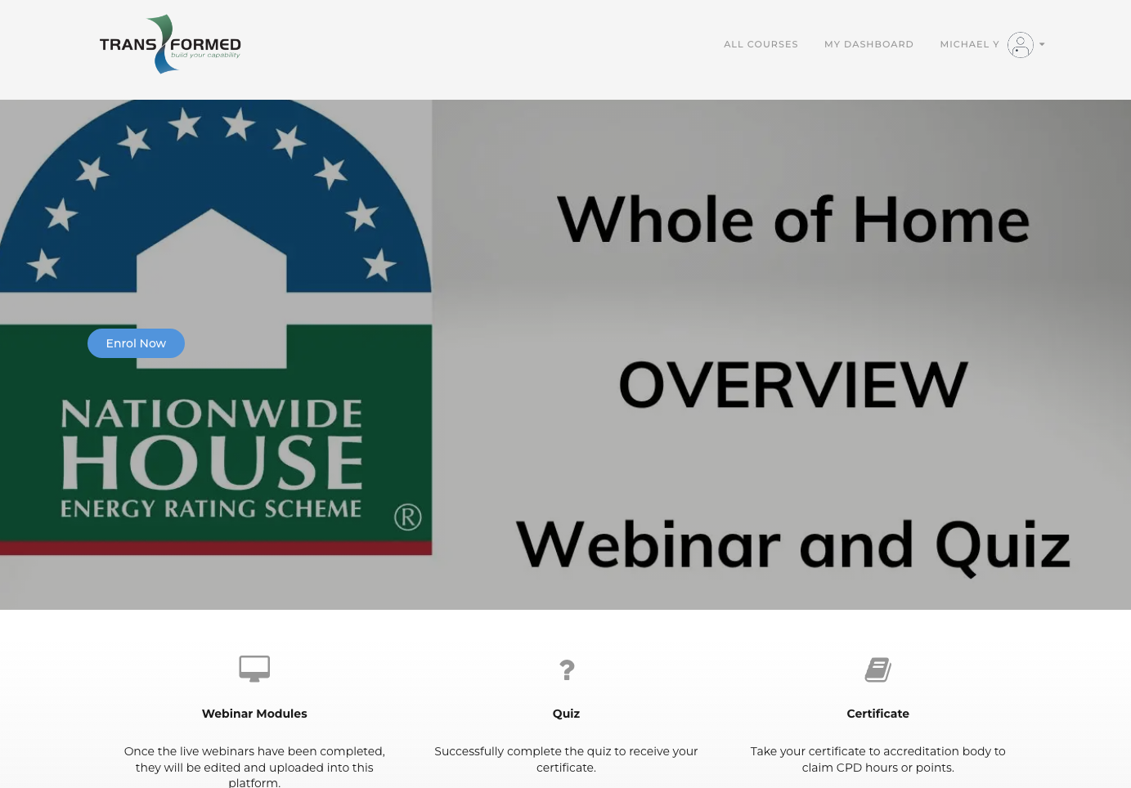

Slide 58
Questions?

Slide 59
Name
Division
Phone: +61 2 XXXX XXXX
John Gorton Building, King Edward Terrace,
Parkes ACT 2600
GPO Box 858 Canberra ACT 2601
DCCEEW.gov.au

Slide 60
Feedback
Is the webinar too long / too short?
What else should be added?
What should be removed?
Any general comments
Send to: info@transformed.com.au
Submit by: 20 Feb 2023

